Slide 1
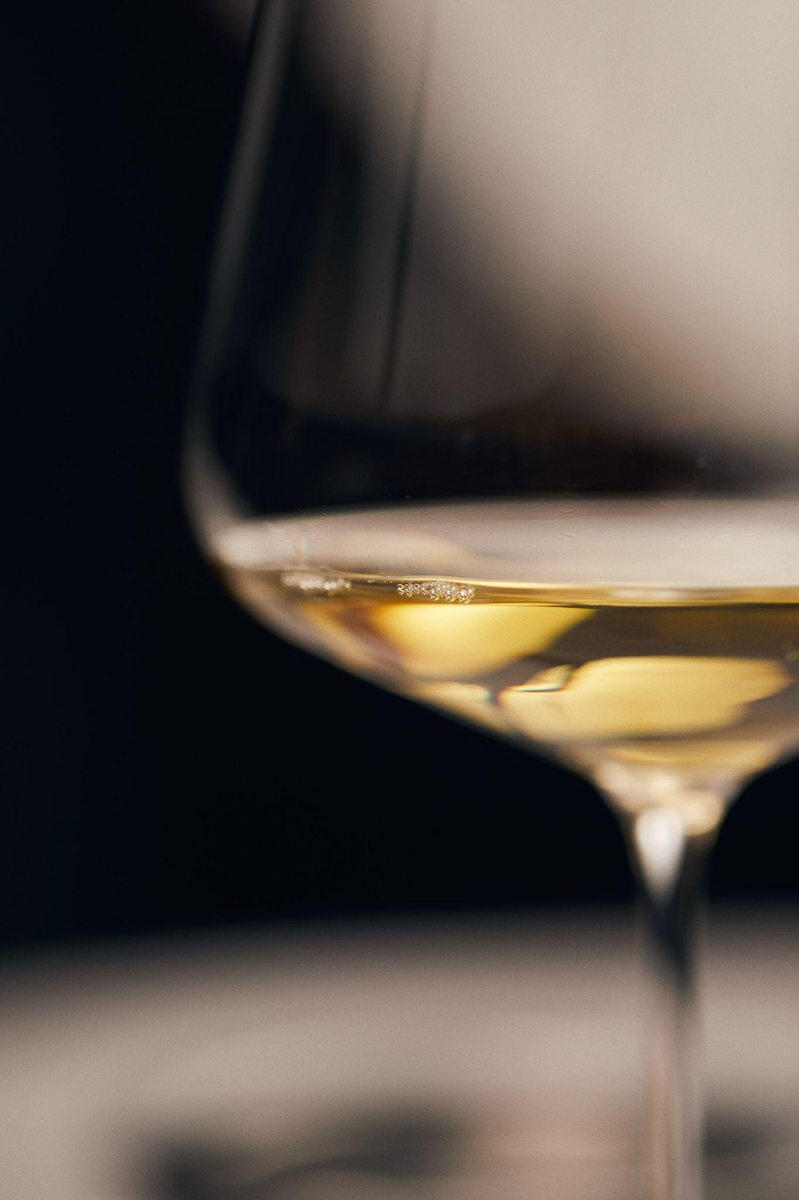
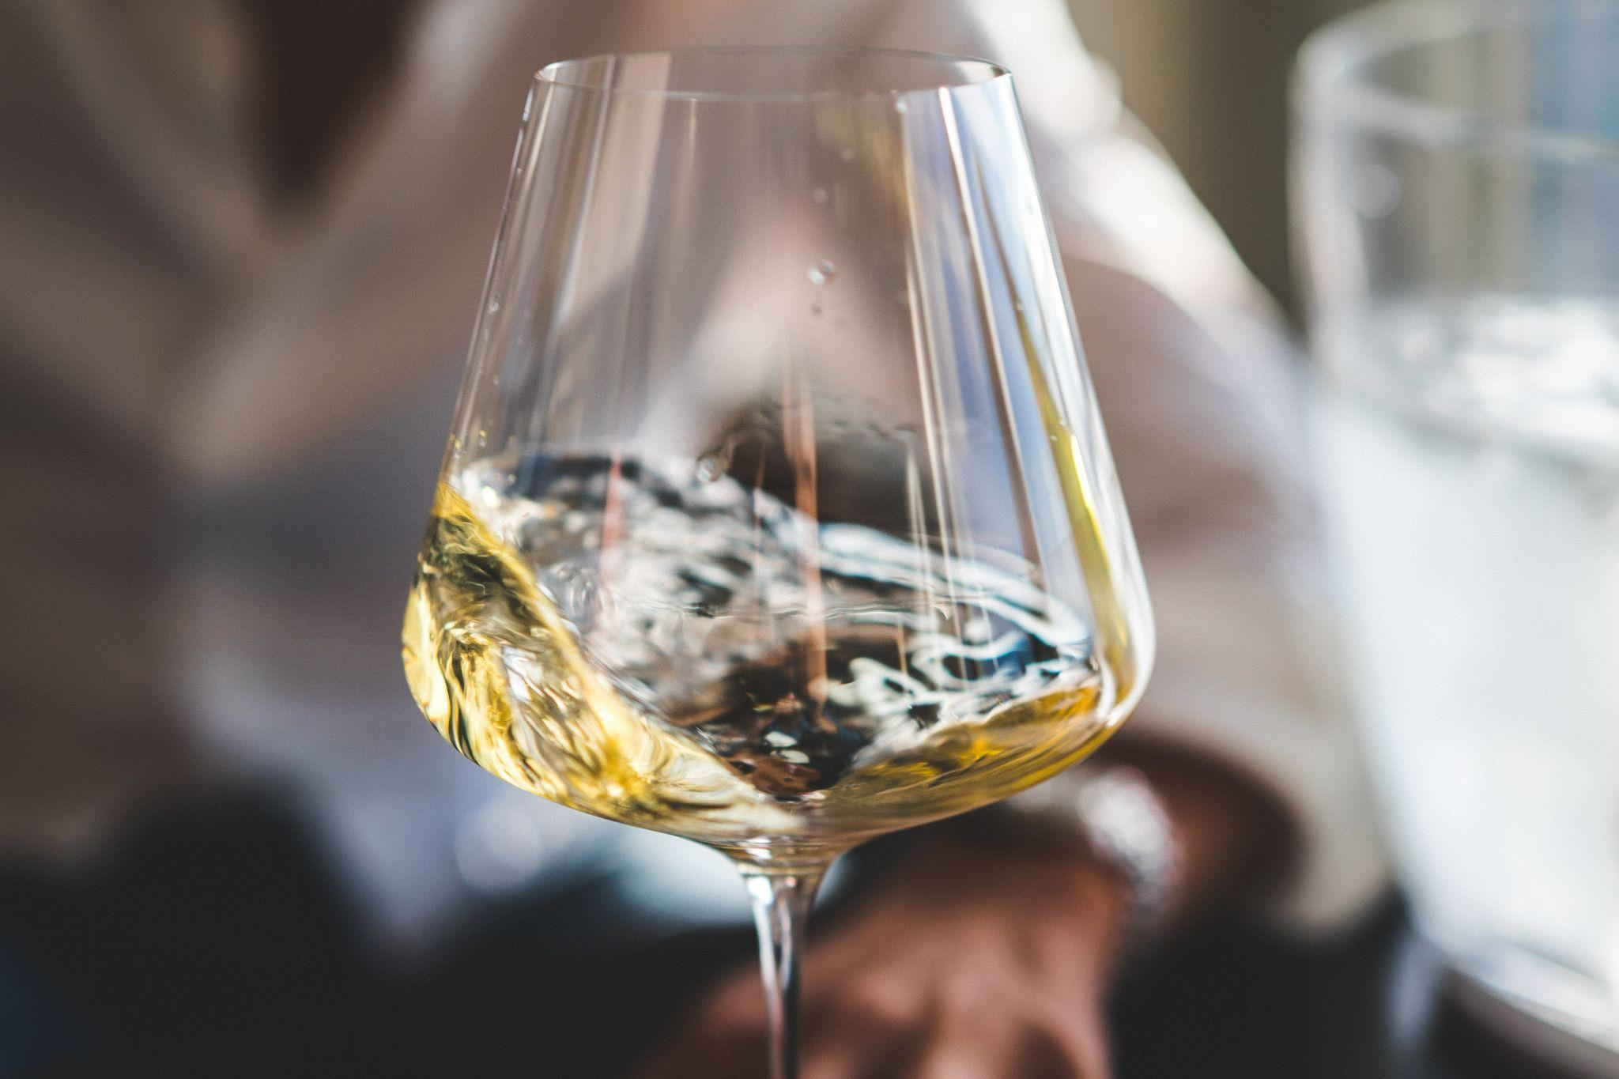
Wine Faults
Sietze Wijma
Notes:
Welcome everybody to this online version of the wine faults class. This session will be recorded and uploaded to YouTube afterwards.
Welcome to the most delicious wine tasting you will ever go to! Please resist the temptation to
Photo by Corina Rainer on Unsplash
Photo by Big Dodzy on Unsplash

Slide 2




Wine Faults
Sietze Wijma
The Art of Tasting
MSc Sensory Science
WSET Level 4 Diploma in Wines
Advanced Cicerone®
Notes:
Today is about two things. First, you will become a better wine taster. Second, you will learn about some important wine flavours and where they originate from. My name is Sietze and I am from the Netherlands. Dutch wine … is an oxymoron.
Wageningen (unpronounceable name) University. WSET. Certified Cicerone® (beer equivalent of sommelier).
After we tasted the first wine, I am going to ask you to introduce yourself. At least, tell me your name, what you do, what wine means to you. Maybe you work in the industry, maybe you are just interested, or maybe you actually prefer beer! If you have a claim to fame, such as having a qualification of some sort, or having scored 100% in one of my previous tastings, let us know!

Slide 3
Introduction
What is a wine fault?
Undesirable flavour in wine
Detracts from quality
Depends on
Wine style
Level of fault
Wine faults
Notes:
Each of your samples are based on the same wine.
Each of the rest of your samples contains a different single wine flavour compound added to it.
For these samples I have used AROXA flavour standards. These are food grade and therefore safe to smell and taste. These are the same compounds that naturally occur in wine, at a level that is close to what you typically find in wine.
Blind tasting test: at the end, we will change the order of the samples and do a blind tasting test. In terms of becoming a better taster, this is the most important part of the evening. Please do not consume your entire sample.

Slide 4
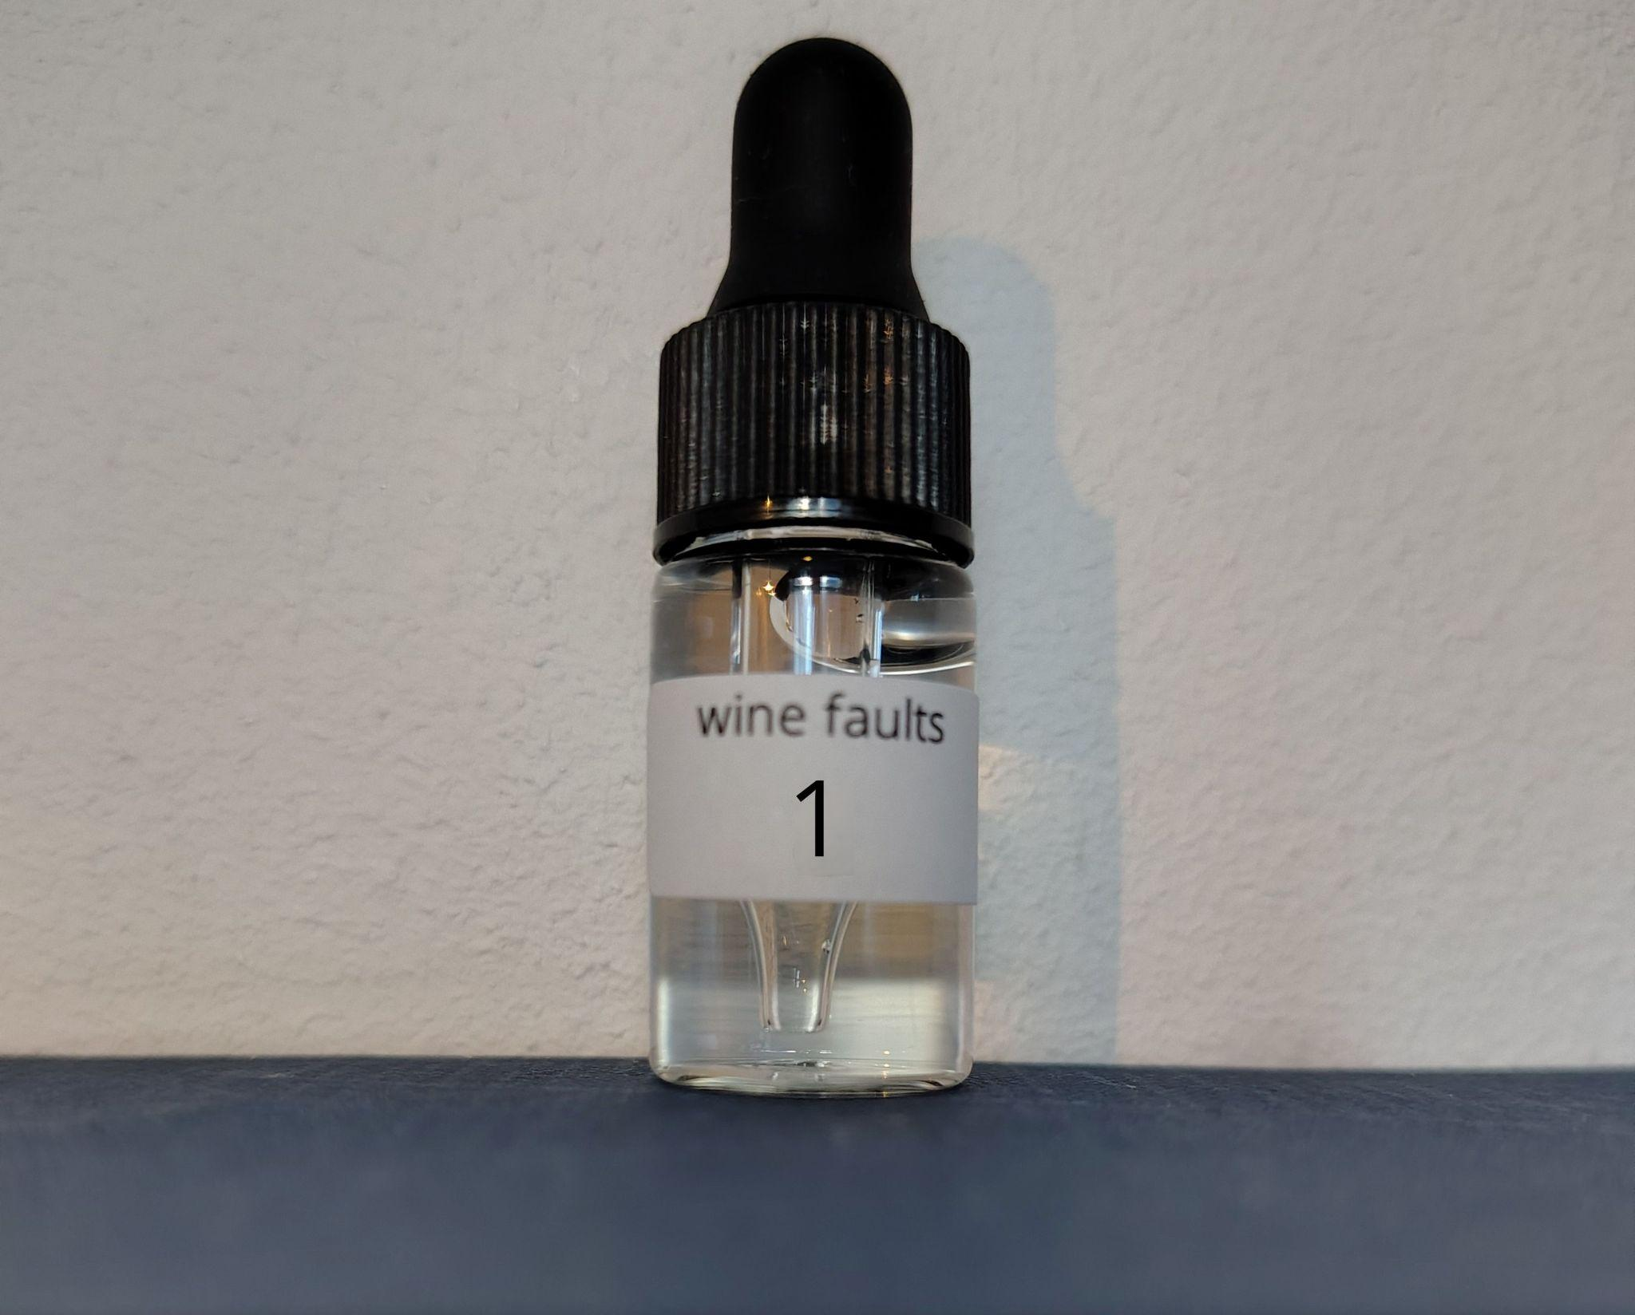
Introduction
Wine samples
11 samples
Same base wine
Food-grade flavour compounds
Safe to smell and taste
Wine faults
This session
Trying the samples
Blind tasting test
Blending activity
Powerpoint slides
Notes:
Each of your samples are based on the same wine.
Each of the rest of your samples contains a different single wine flavour compound added to it.
For these samples I have used AROXA flavour standards. These are food grade and therefore safe to smell and taste. These are the same compounds that naturally occur in wine, at a level that is close to what you typically find in wine.
Blind tasting test: at the end, we will change the order of the samples and do a blind tasting test. In terms of becoming a better taster, this is the most important part of the evening. Please do not consume your entire sample.

Slide 5
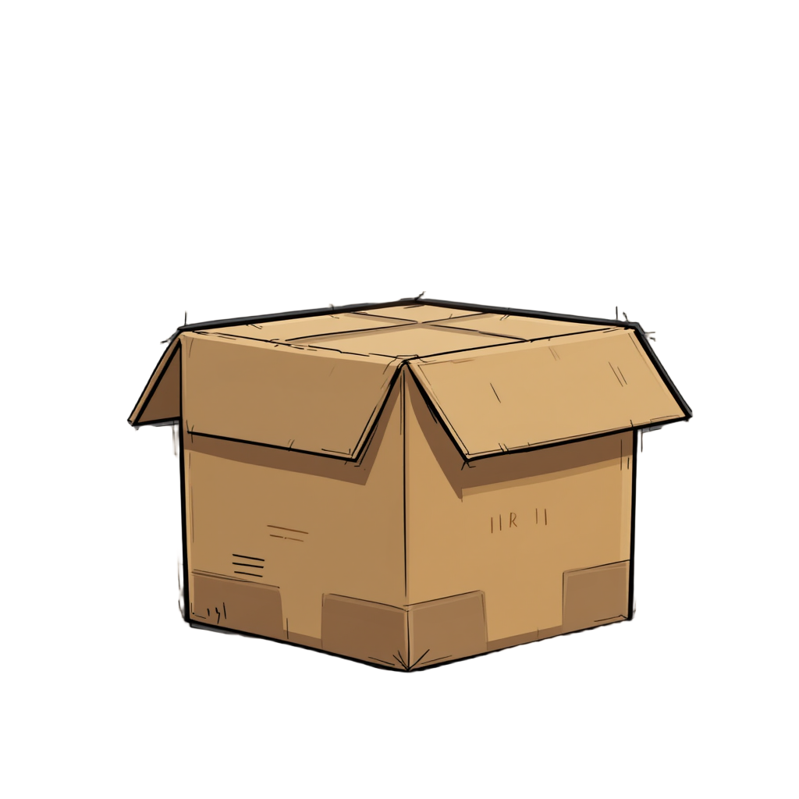
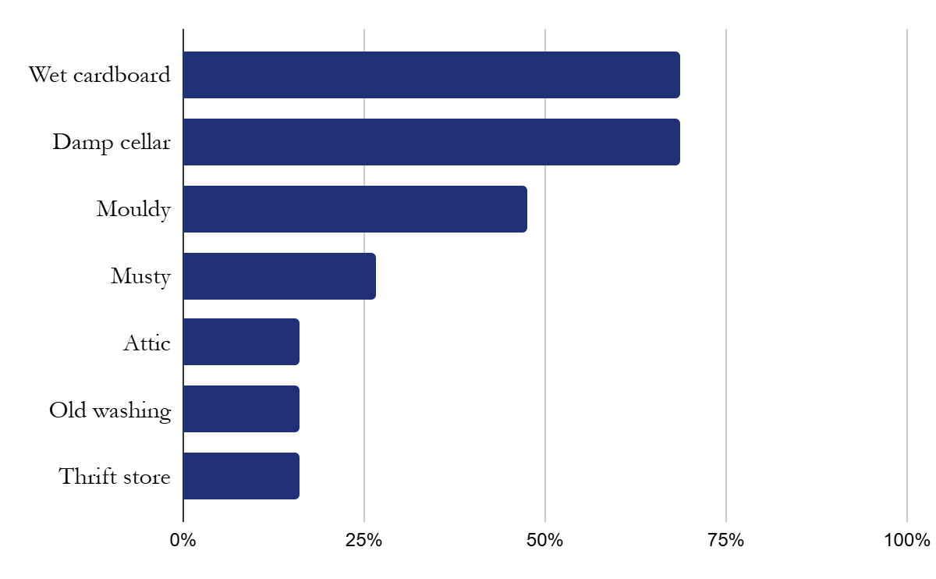
Wet cardboard
Sample 1
Wine faults

Slide 6
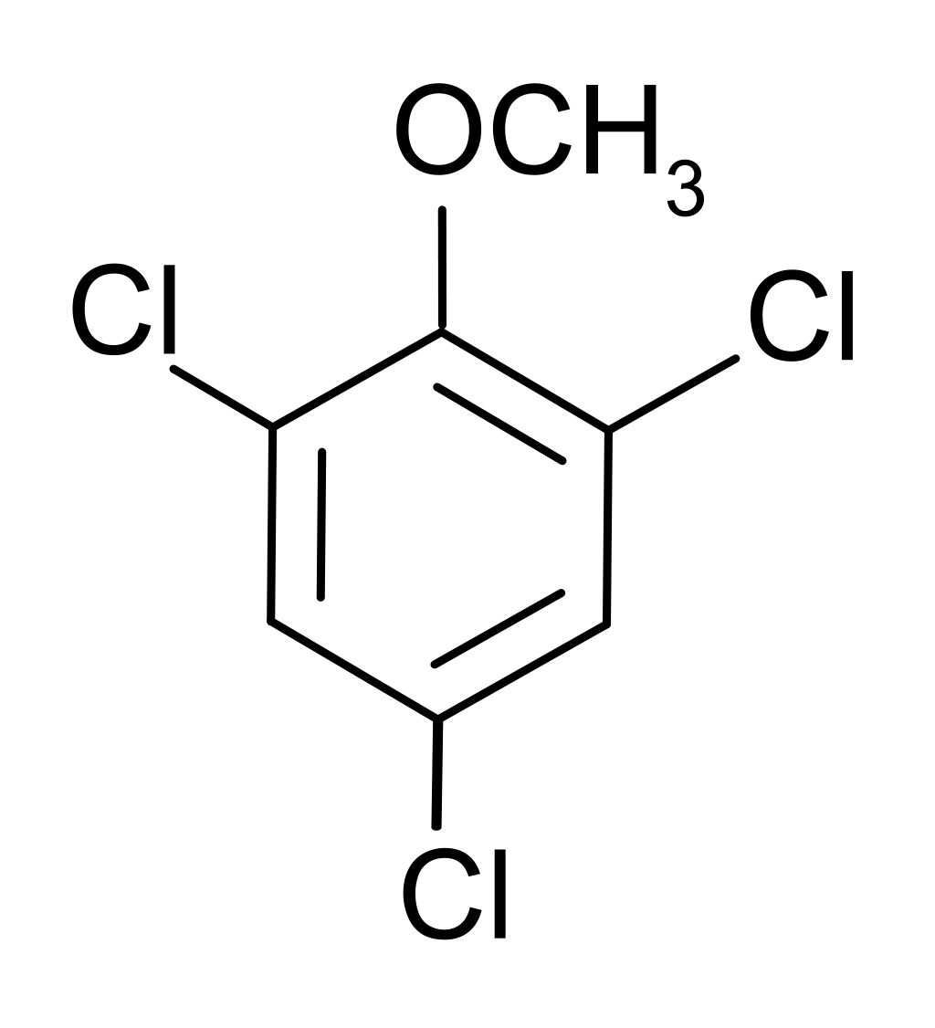
Wet cardboard
Sample 1
TCA
Class: Phenols
Fault
Cork taint
Origins
Wine faults
Threshold:
4 ng/L
Mould, chlorine, phenolics
Prevention
1 | Wet cardboard
2
3
4
5
6
7
8
9
10
Cork tree cultivation, cork production, alternative closures

Slide 7
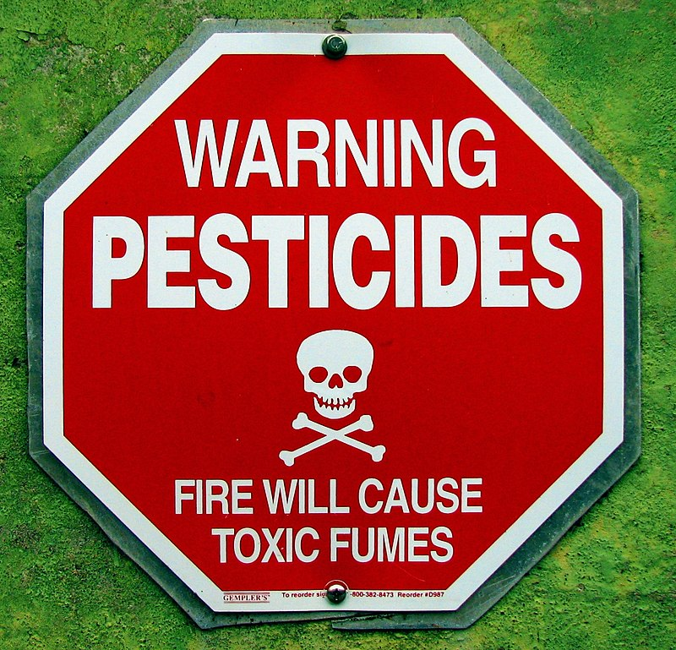
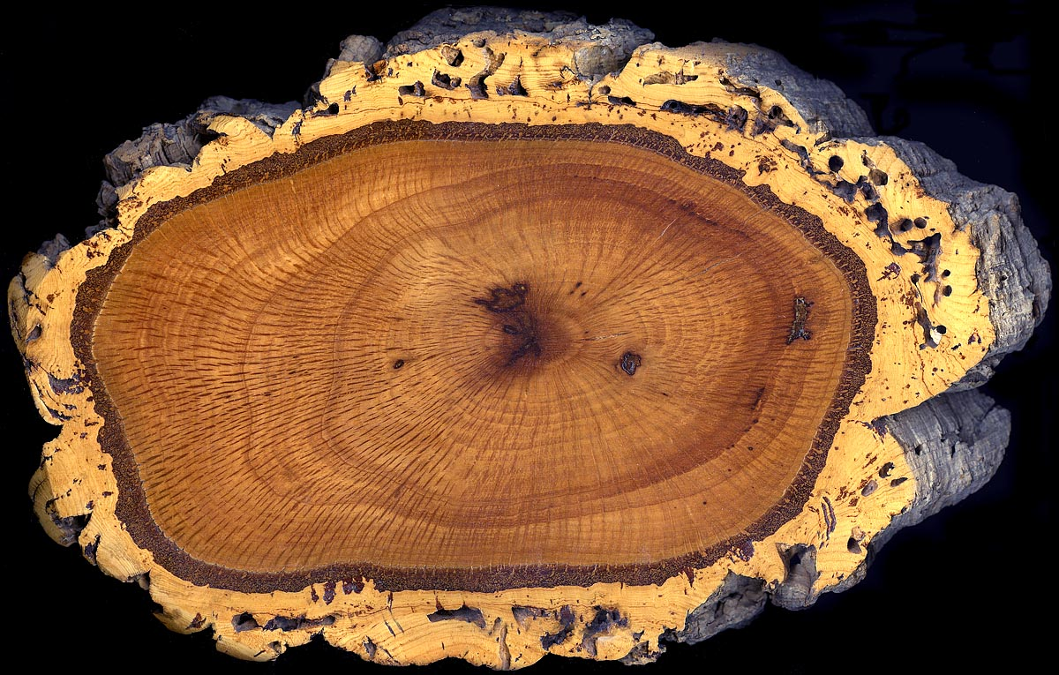
(biocide-derived) (bark-derived)
chlorine + phenolics → TCP
(mould activity)
TCP → TCA
Notes:
Pathway
By http://www.cgpgrey.com, CC BY-SA 3.0, https://commons.wikimedia.org/w/index.php?curid=12118665
By Plantsurfer - en:Image:Cork oak trunk section.jpg, Public Domain, https://commons.wikimedia.org/w/index.php?curid=2602705

Slide 8
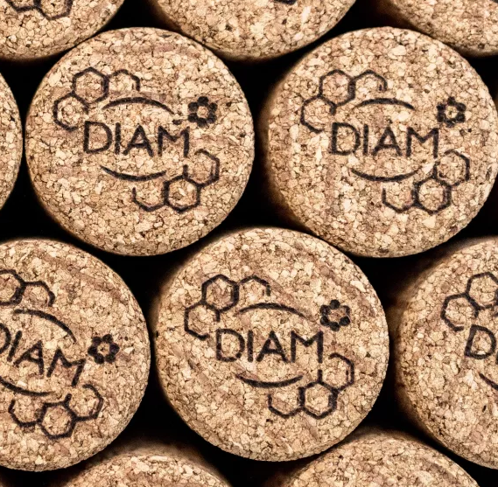
Wet cardboard
Sample 1
Wine faults

Slide 9
Wet cardboard
Sample 1
TCA
Wine faults
Alcohol | 12%
TCA | 0.0000000003%
Threshold:
4 ng/L
Notes:
A sugar granule is about 1 mg.
A thousand ng go into 1 µg. A thousand µg go into 1 mg. A thousand mg go into 1 g. Only 0.0000000001% of your wine has to consist of 4-MMP to give a box tree flavour.
When I first learned that wine was about 85% water, I was almost disappointed.
A millionth of a sugar granule

Slide 10
Sample 2
Wine faults

Slide 11
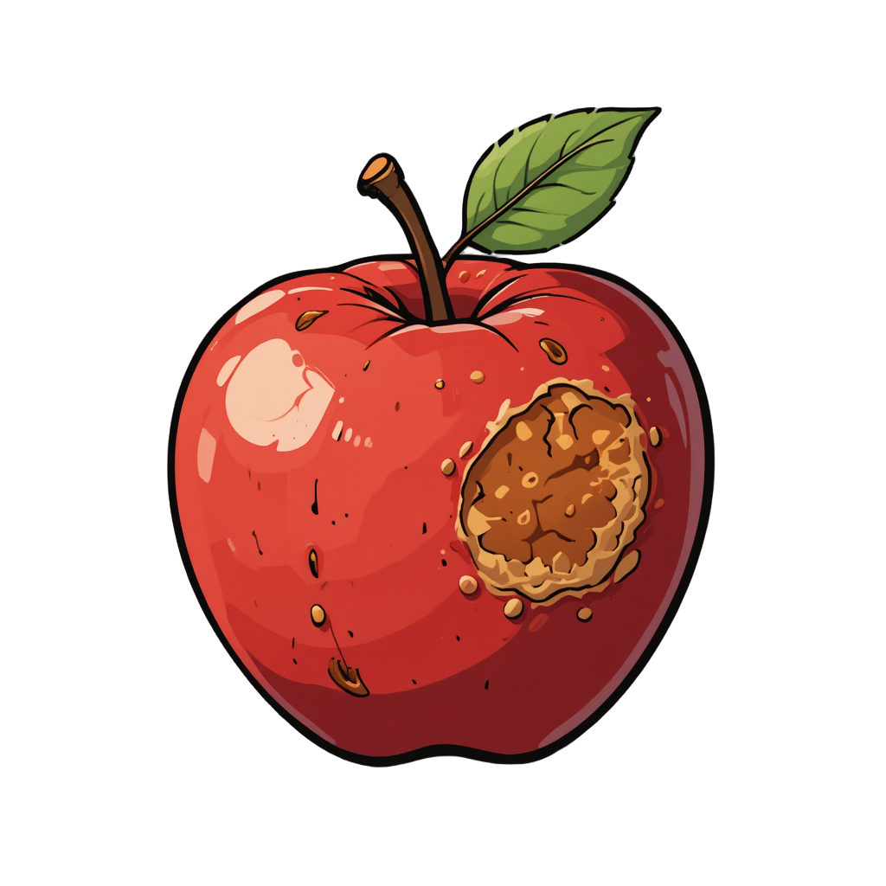
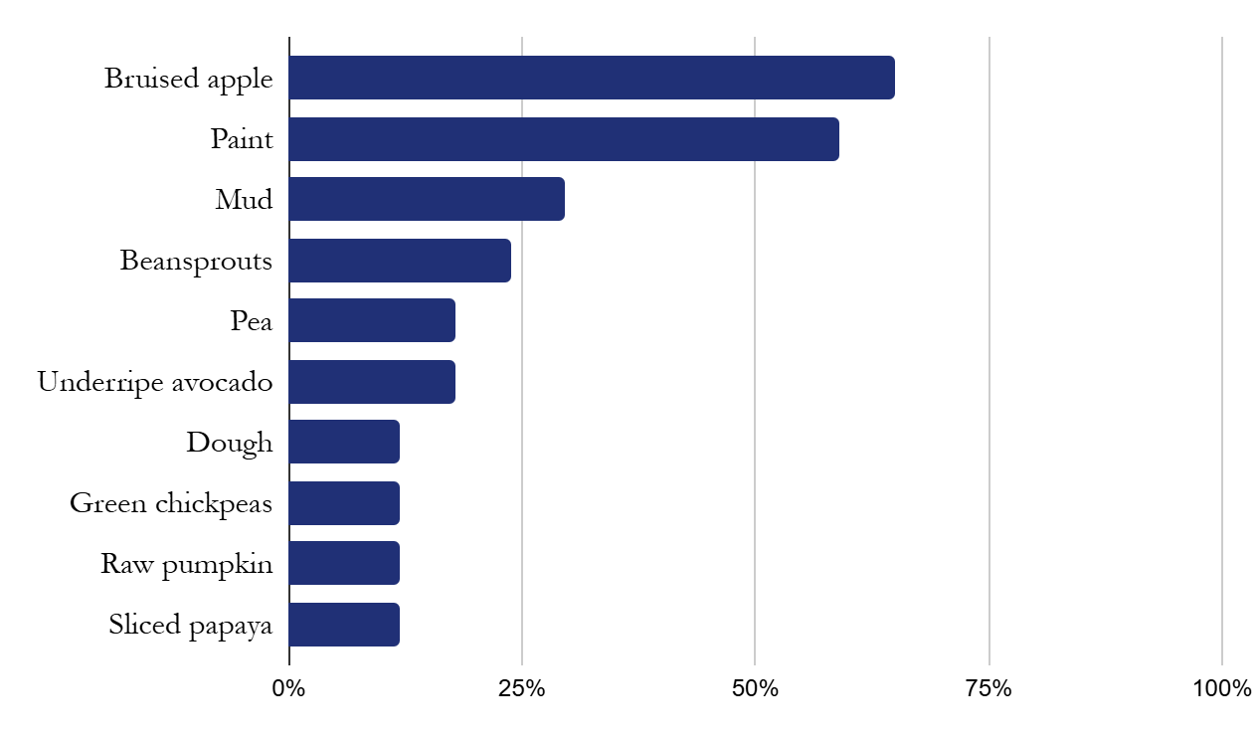
Bruised apple
Sample 2
Wine faults

Slide 12

Bruised apple
Sample 2
acetaldehyde
Class: Aldehydes
Fault
Oxidation
Origins
Wine faults
Threshold:
8 mg/L
Fermentation, oxidation
Prevention
1 | Wet cardboard
2 | Bruised apple
3
4
5
6
7
8
9
10
Managing oxygen, healthy fermentation, SO₂

Slide 13
Sample 3
Wine faults

Slide 14
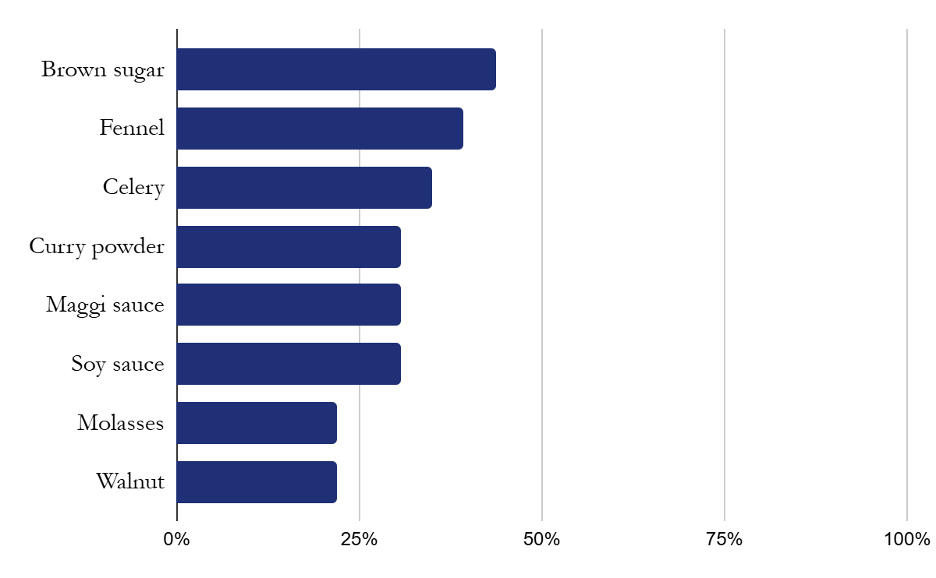
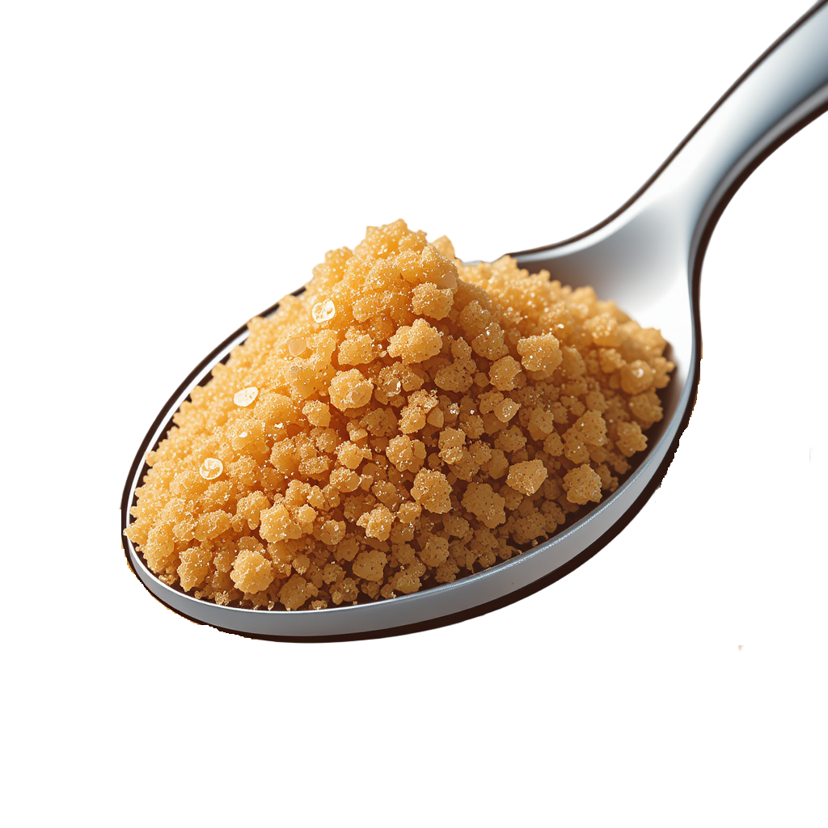
Brown sugar
Sample 3
Wine faults

Slide 15
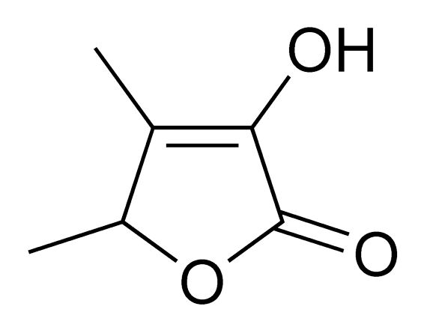
Brown sugar
Sample 3
sotolon
Class: Lactone
Fault
Oxidation
Origins
Wine faults
Threshold:
6 µg/L
Transformation of wine components by oxygen
Prevention
1 | Wet cardboard
2 | Bruised apple
3 | Brown sugar
4
5
6
7
8
9
10
Tannins, acidity, SO₂, bottle closure

Slide 16
Wine faults
Taint
Off-flavour
Wine faults
Notes:
Example questions:
Education programme? WSET, MW, CMS?
Why is it relevant to be able to identify faults?

Slide 17
Sample 4
Wine faults

Slide 18
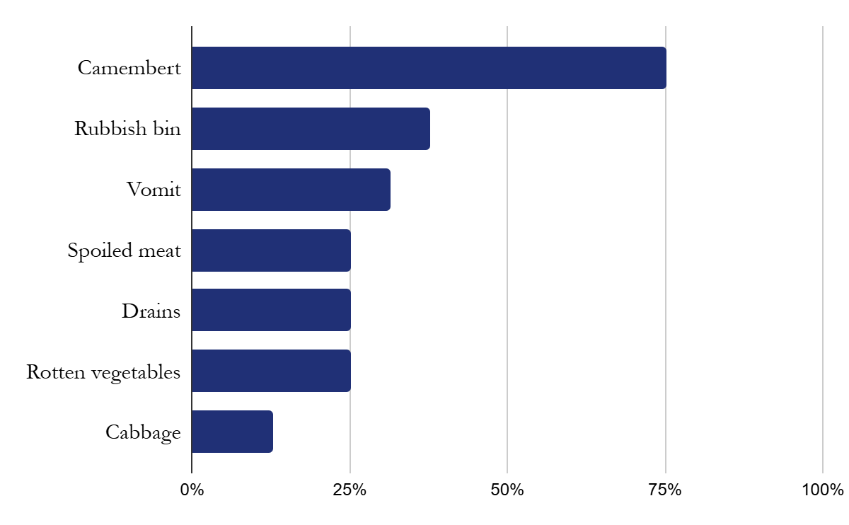
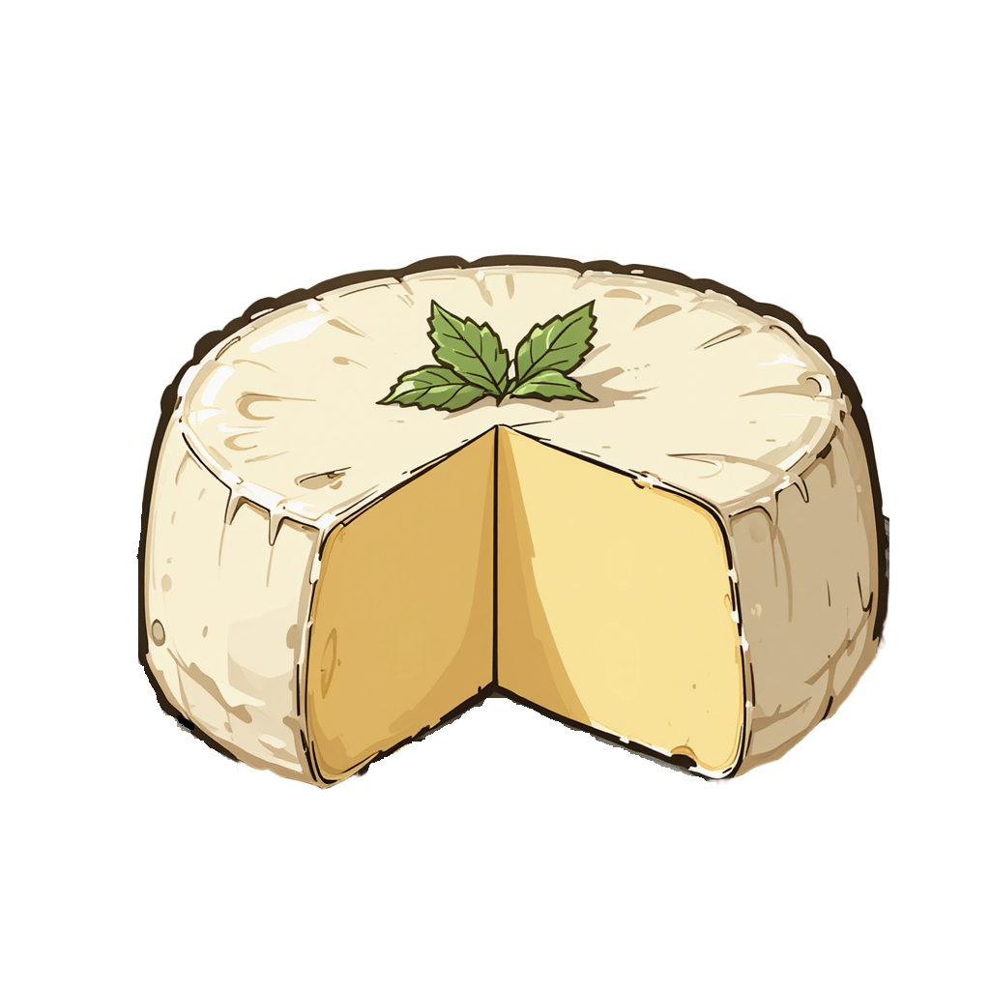
Camembert
Sample 4
Wine faults

Slide 19
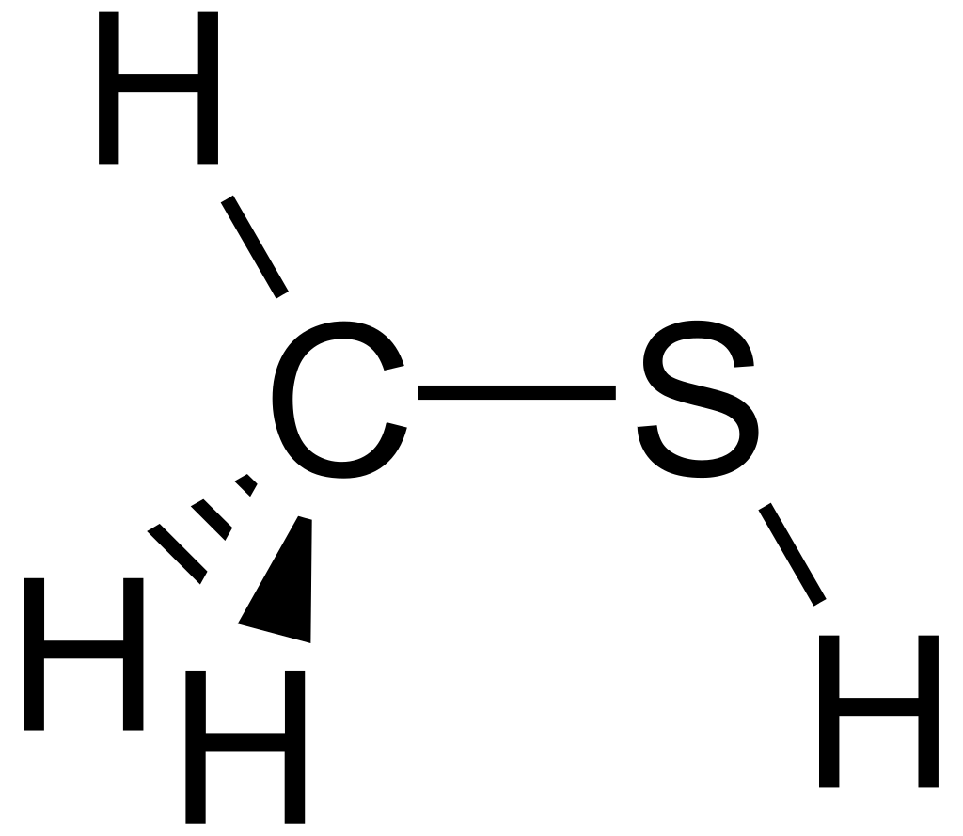
Camembert
Sample 4
methyl mercaptan
Class: Sulphur compounds
Fault
Reduction, light strike
Origins
Wine faults
Threshold:
4 µg/L
Yeast stress
Prevention
1 | Wet cardboard
2 | Bruised apple
3 | Brown sugar
4 | Camembert
5
6
7
8
9
10
Managing yeast nutrients, oxygen, bottle closures
Remedies
Oxygen exposure, copper

Slide 20
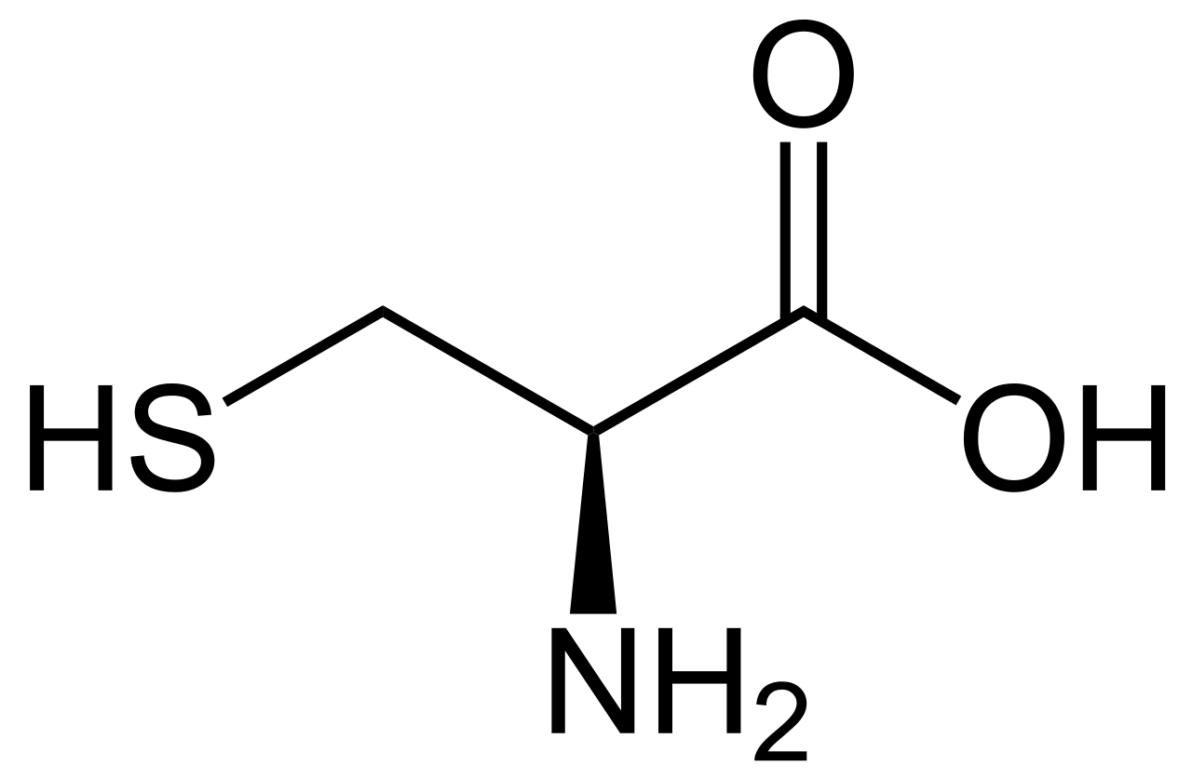
Cysteine
Wine faults

Slide 21
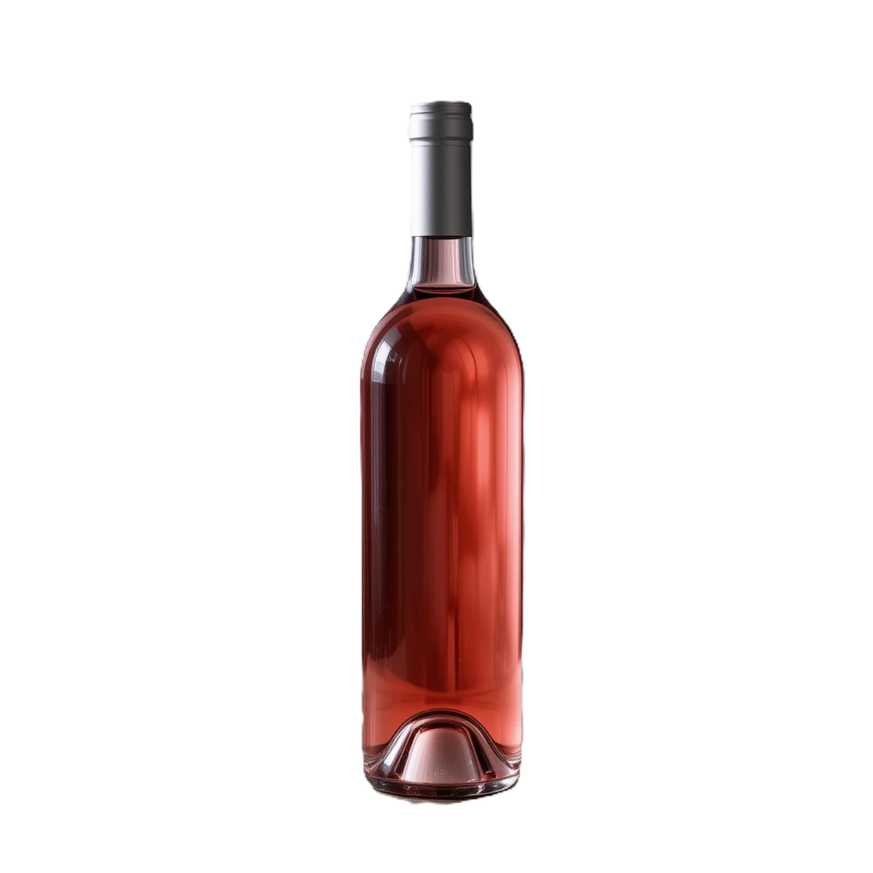
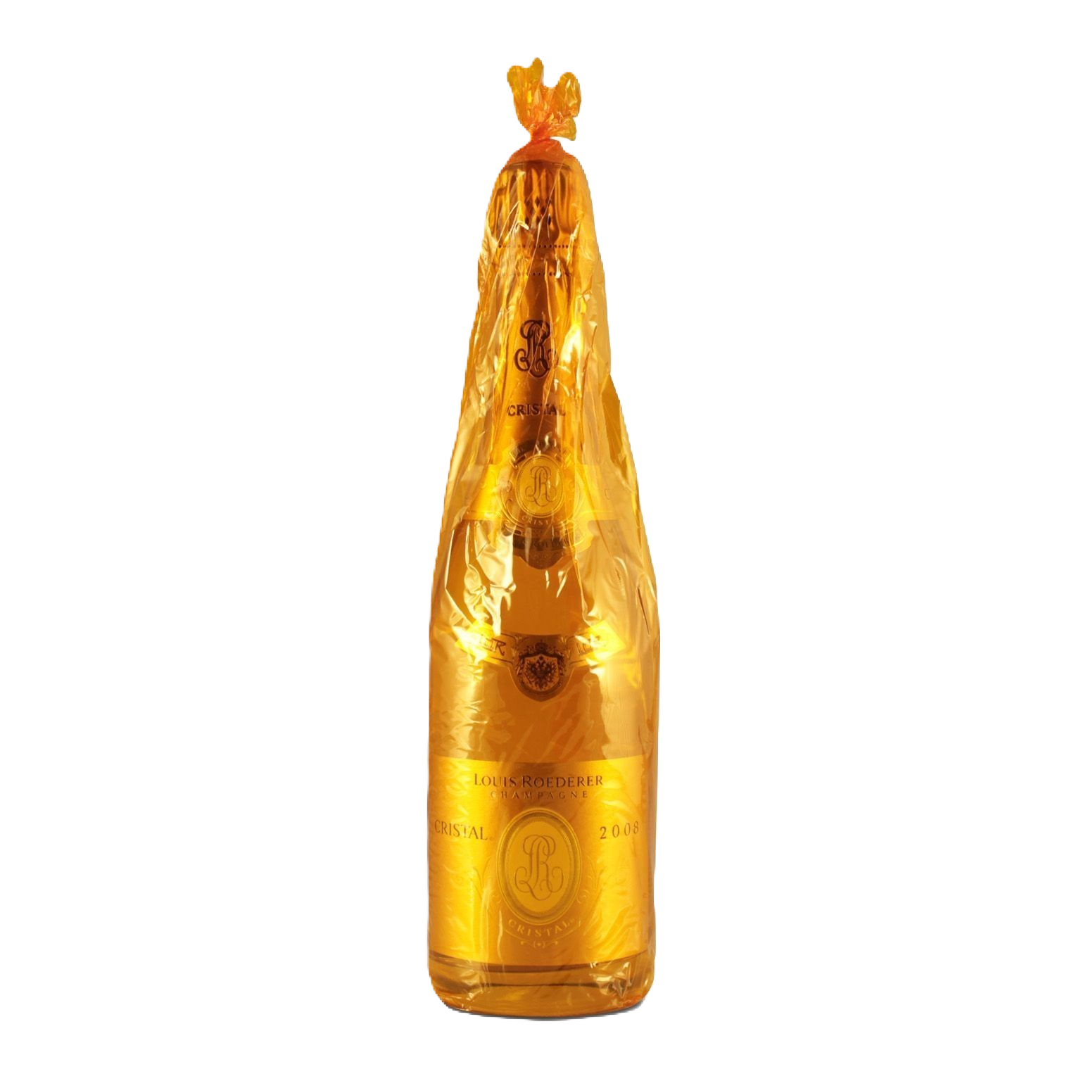
Lightstrike
Wine faults

Slide 22
Sample 5
Wine faults

Slide 23
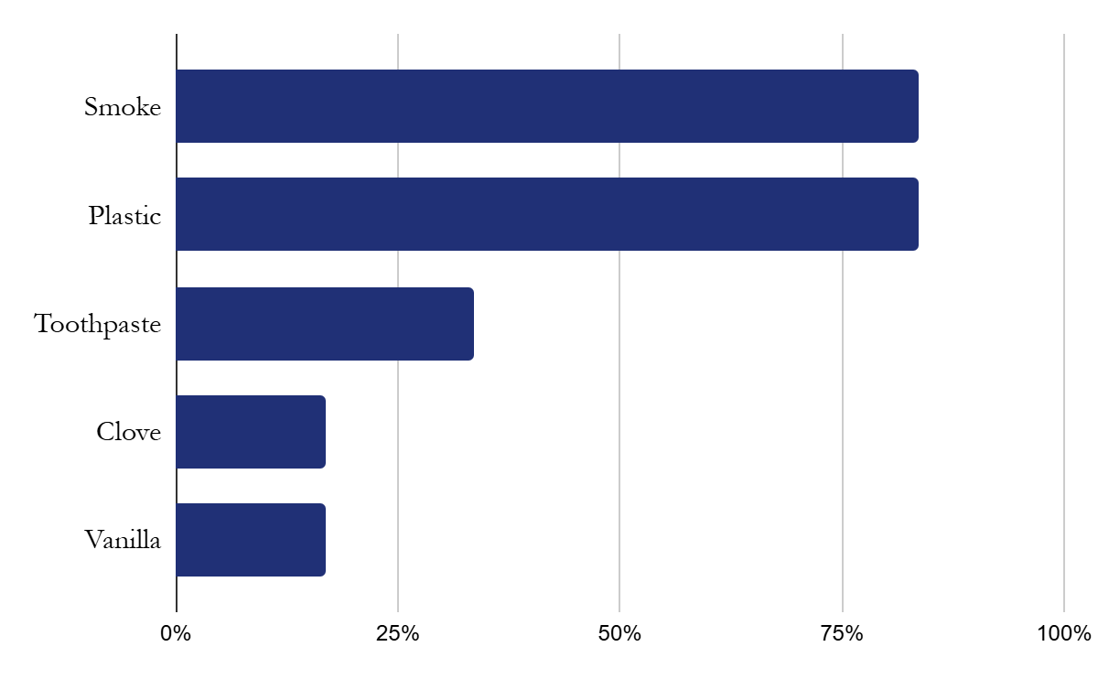
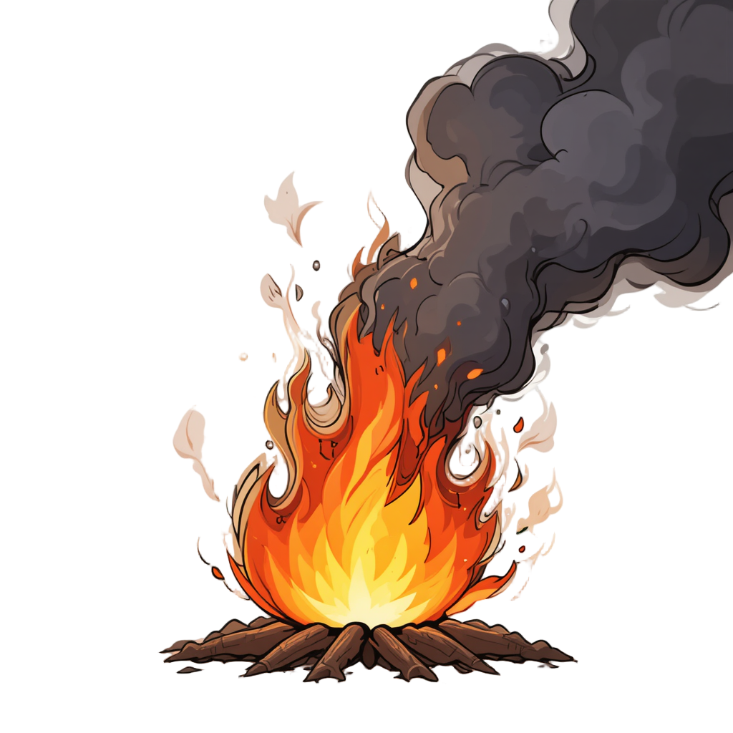
Smoke
Sample 5
Wine faults

Slide 24
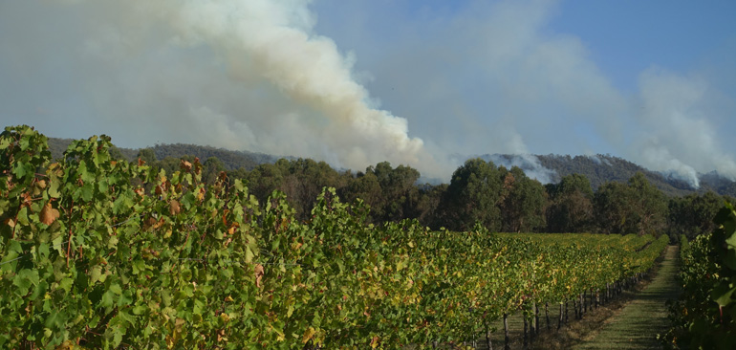
Smoke
Sample 5
Wine faults
Photo by Dr Ian Porter at La Trobe University in Melbourne, Australia

Slide 25
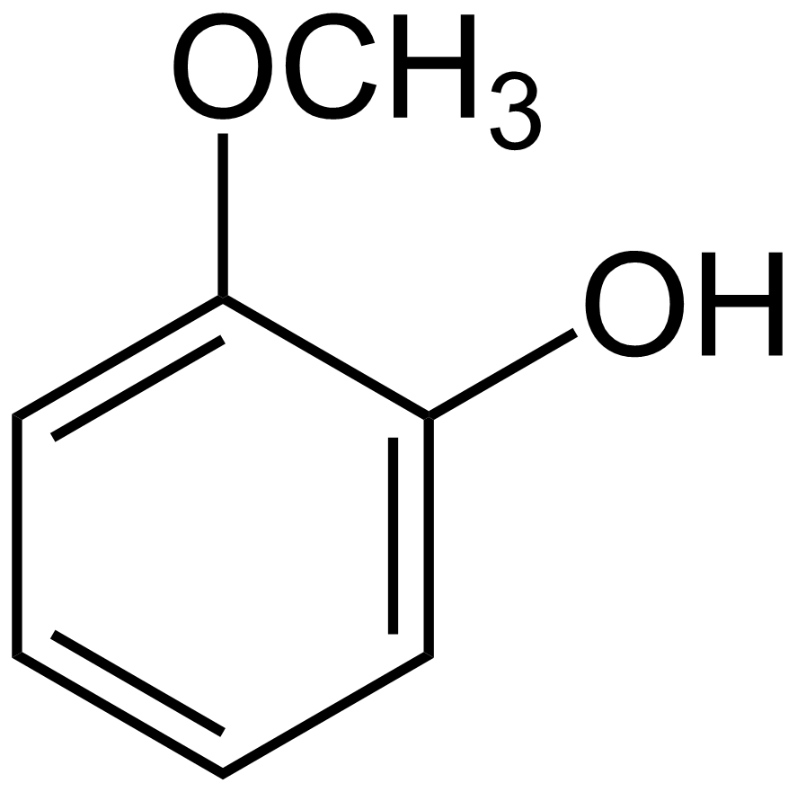
Smoke
Sample 5
guaiacol
Class: Phenols
Fault
Smoke taint
Origins
Wine faults
Threshold:
40 µg/L
Wildfires
Prevention
1 | Wet cardboard
2 | Bruised apple
3 | Brown sugar
4 | Camembert
5 | Smoke
6
7
8
9
10
Adopting gentle grape processing
Remedies
Reverse osmosis

Slide 26
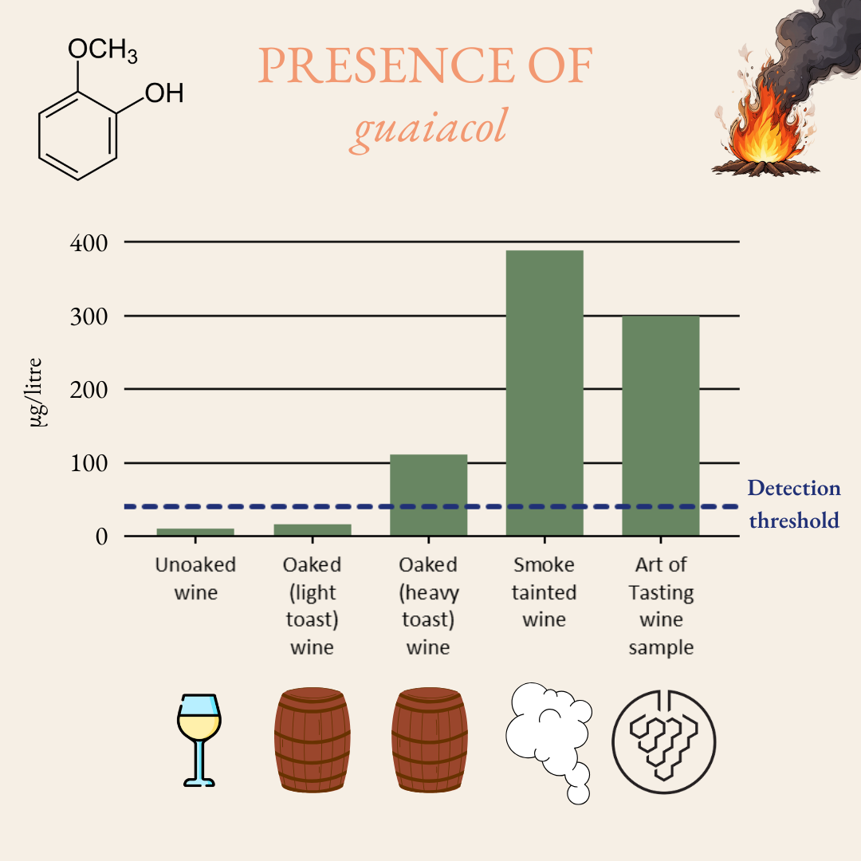
Smoke
Sample 5
Wine faults
Notes:
Chira 2013 - Extraction of oak volatiles and ellagitannins compounds and sensory profile of wine aged with French winewoods subjected to different toasting methods Behaviour during storage
Kennison 2009 - Effect of timing and duration of grapevine exposure to smoke on the composition and sensory properties of wine

Slide 27
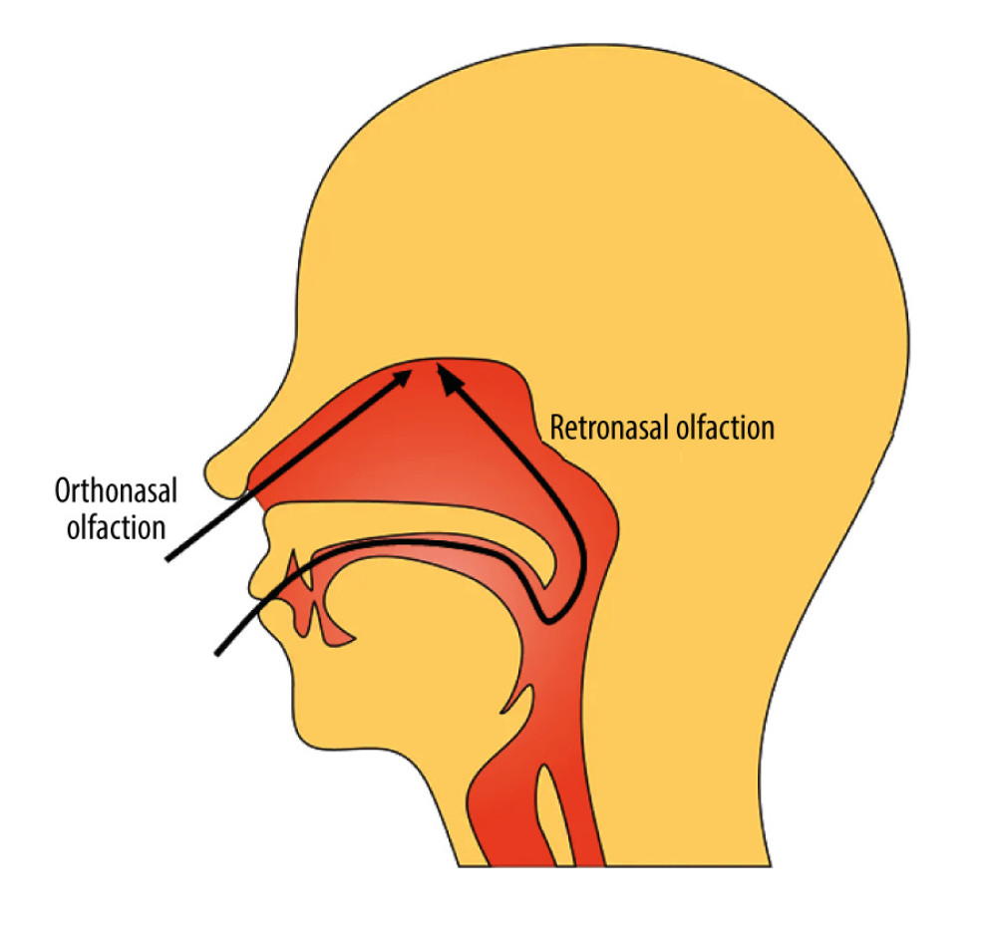
Wine faults
Hirano et al. 2022
Notes:
A 32-Year-Old Man with Persistent Olfactory Dysfunction Following COVID-19 Whose Recovery Was Evaluated by Retronasal Olfactory Testing

Slide 28
Specific anosmia rates
1 | Wet cardboard | TCA | Cork taint | 1%
2 | Bruised apple | acetaldehyde | Oxidation | 2%
3 | Brown sugar | sotolon | Oxidation | 3%
4 | Camembert | methyl mercaptan | Reduction | 8%
5 | Smoke | guaiacol | Smoke taint | 4%
Wine flavour compounds

Slide 29
Sample 6
Wine faults

Slide 30
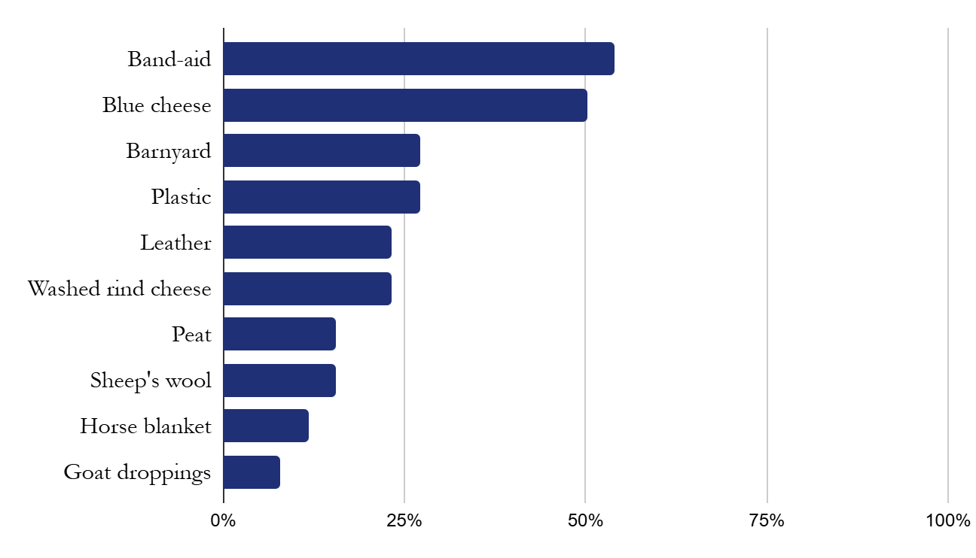

Band-aid
Sample 6
Wine faults
Notes:
Pleasant vs unpleasant: 11 vs 7
Pleasant vs unpleasant: 8 vs 14
Pleasant vs unpleasant: 7 vs 14
Total: 26 vs 35

Slide 31
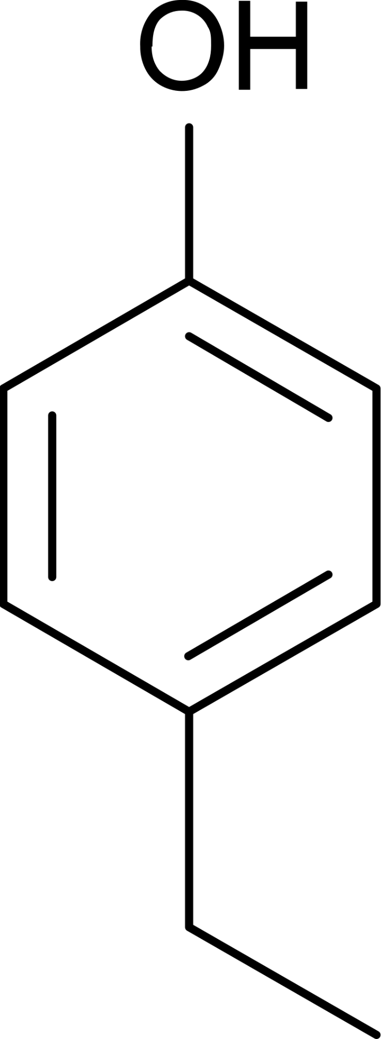
Band-aid
Sample 6
4-EP
Class: Phenols
Fault
Brettanomyces (Brett)
Origins
Wine faults
Fermentation, barrel, bottle
Threshold:
15 µg/L
Prevention
1 | Wet cardboard
2 | Bruised apple
3 | Brown sugar
4 | Camembert
5 | Smoke
6 | Band-aid
7
8
9
10
Managing residual sugar and yeast nutrients, SO₂

Slide 32
Yeast types
Saccharomyces Cerevisiae
Brettanomyces

Slide 33
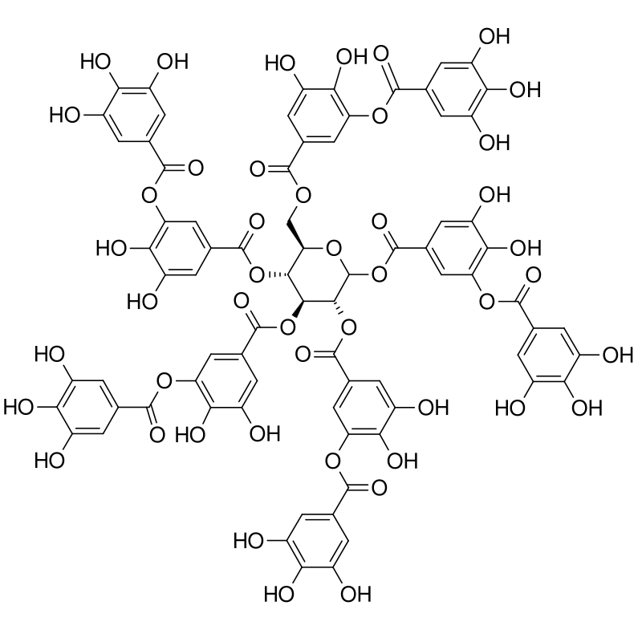
Phenolics

Slide 34
Sample 7
Wine faults

Slide 35
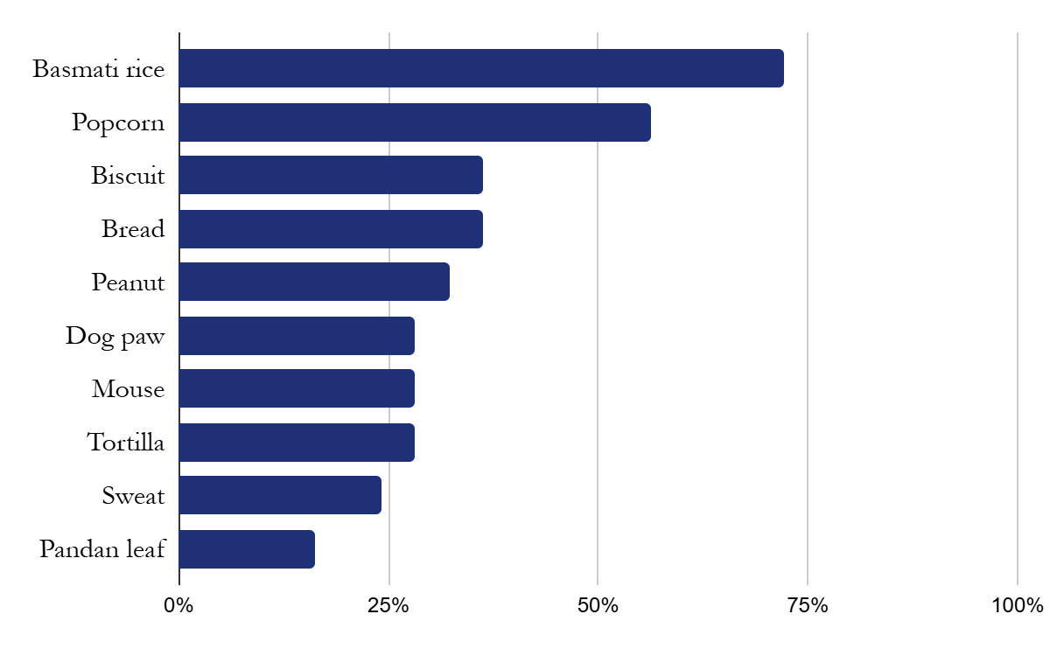
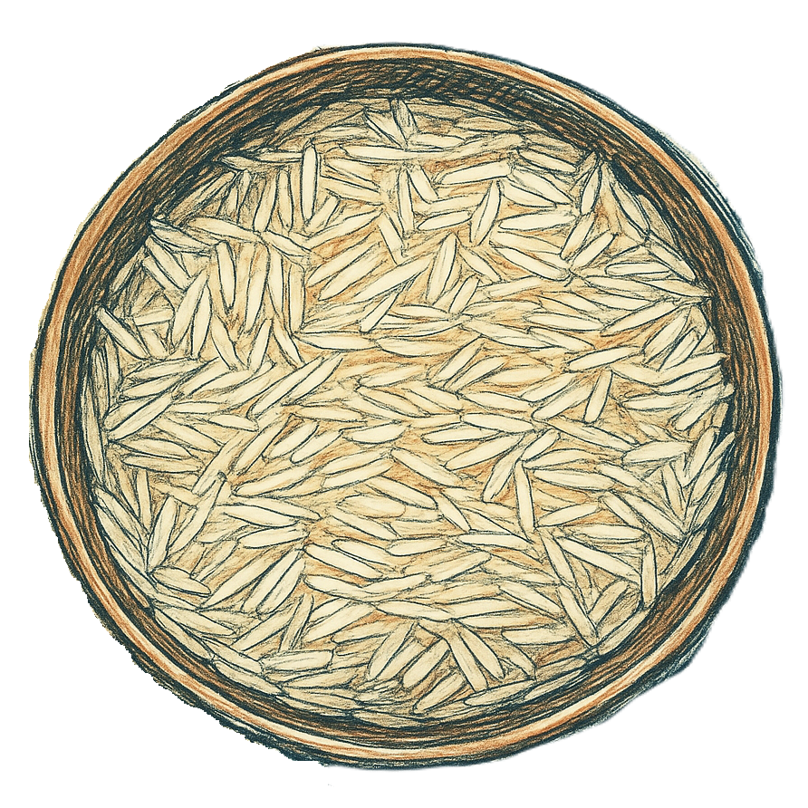
Basmati rice
Sample 7
Wine faults

Slide 36
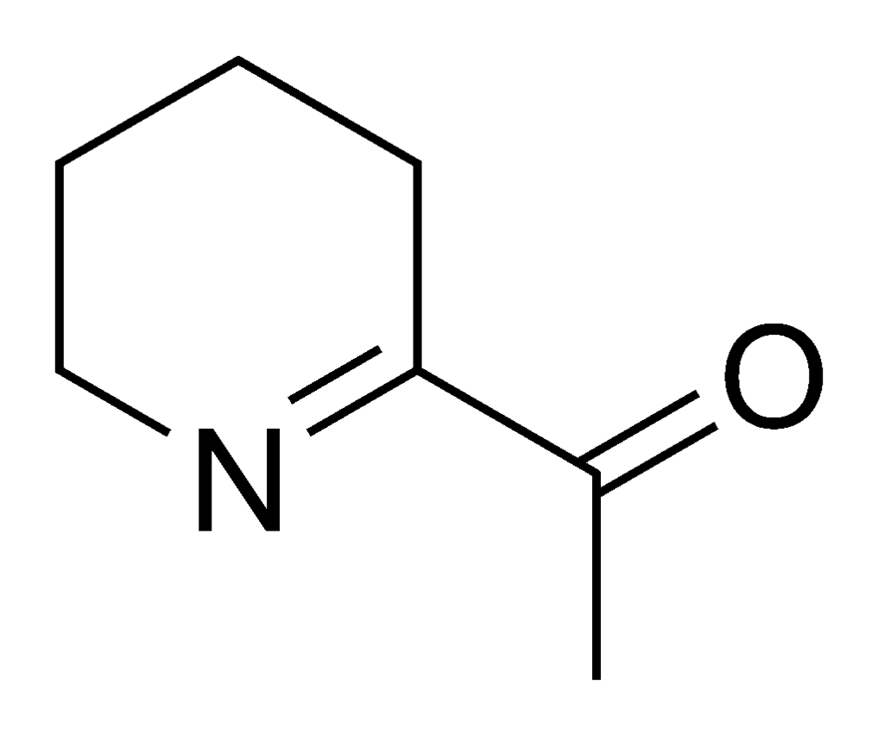
Basmati rice
Sample 7
ATHP
Class: pyridines
Fault
Mousiness
Origins
Wine faults
Lactic acid bacteria
Threshold:
5 µg/L
Prevention
1 | Wet cardboard
2 | Bruised apple
3 | Brown sugar
4 | Camembert
5 | Smoke
6 | Band-aid
7 | Basmati rice
8
9
10
SO₂, cultured yeast/bacteria, low oxygen

Slide 37
Sample 8
Wine faults

Slide 38
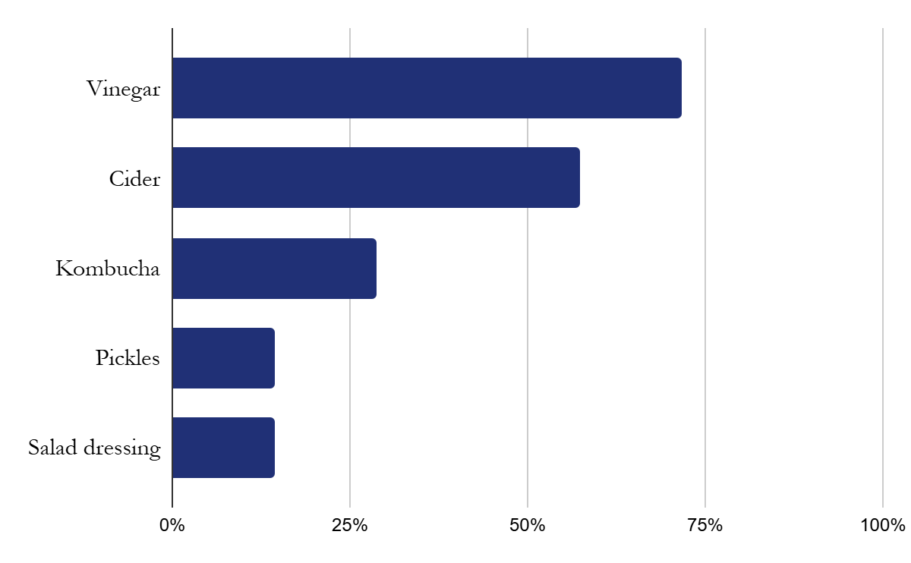
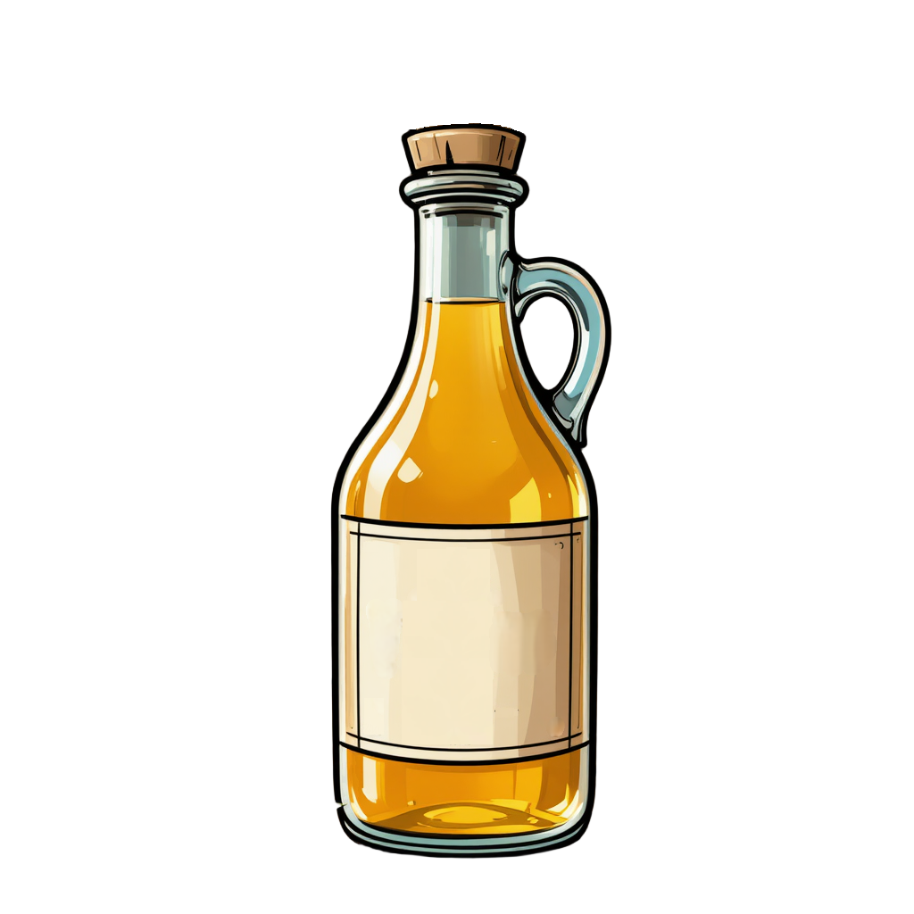
Vinegar
Sample 8
Wine faults

Slide 39
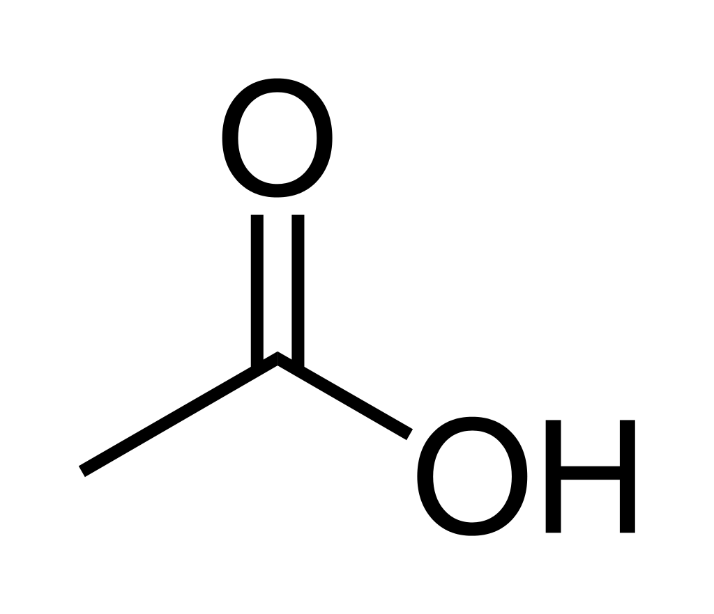
Vinegar
Sample 8
acetic acid
Class: Acids
Fault
Volatile acidity
Origins
Wine faults
Acetic acid bacteria
Threshold:
150 mg/L
Prevention
1 | Wet cardboard
2 | Bruised apple
3 | Brown sugar
4 | Camembert
5 | Smoke
6 | Band-aid
7 | Basmati rice
8 | Vinegar
9
10
Managing oxygen
Notes:
Volatile acidity are acids that can leave the glass, as opposed to those acids that remain in solution. In other words, volatile acidity are the acids you can smell. Legal limits: Australia 1.5 g/litre. US 1.4 (red), 1.2 (white)

Slide 40
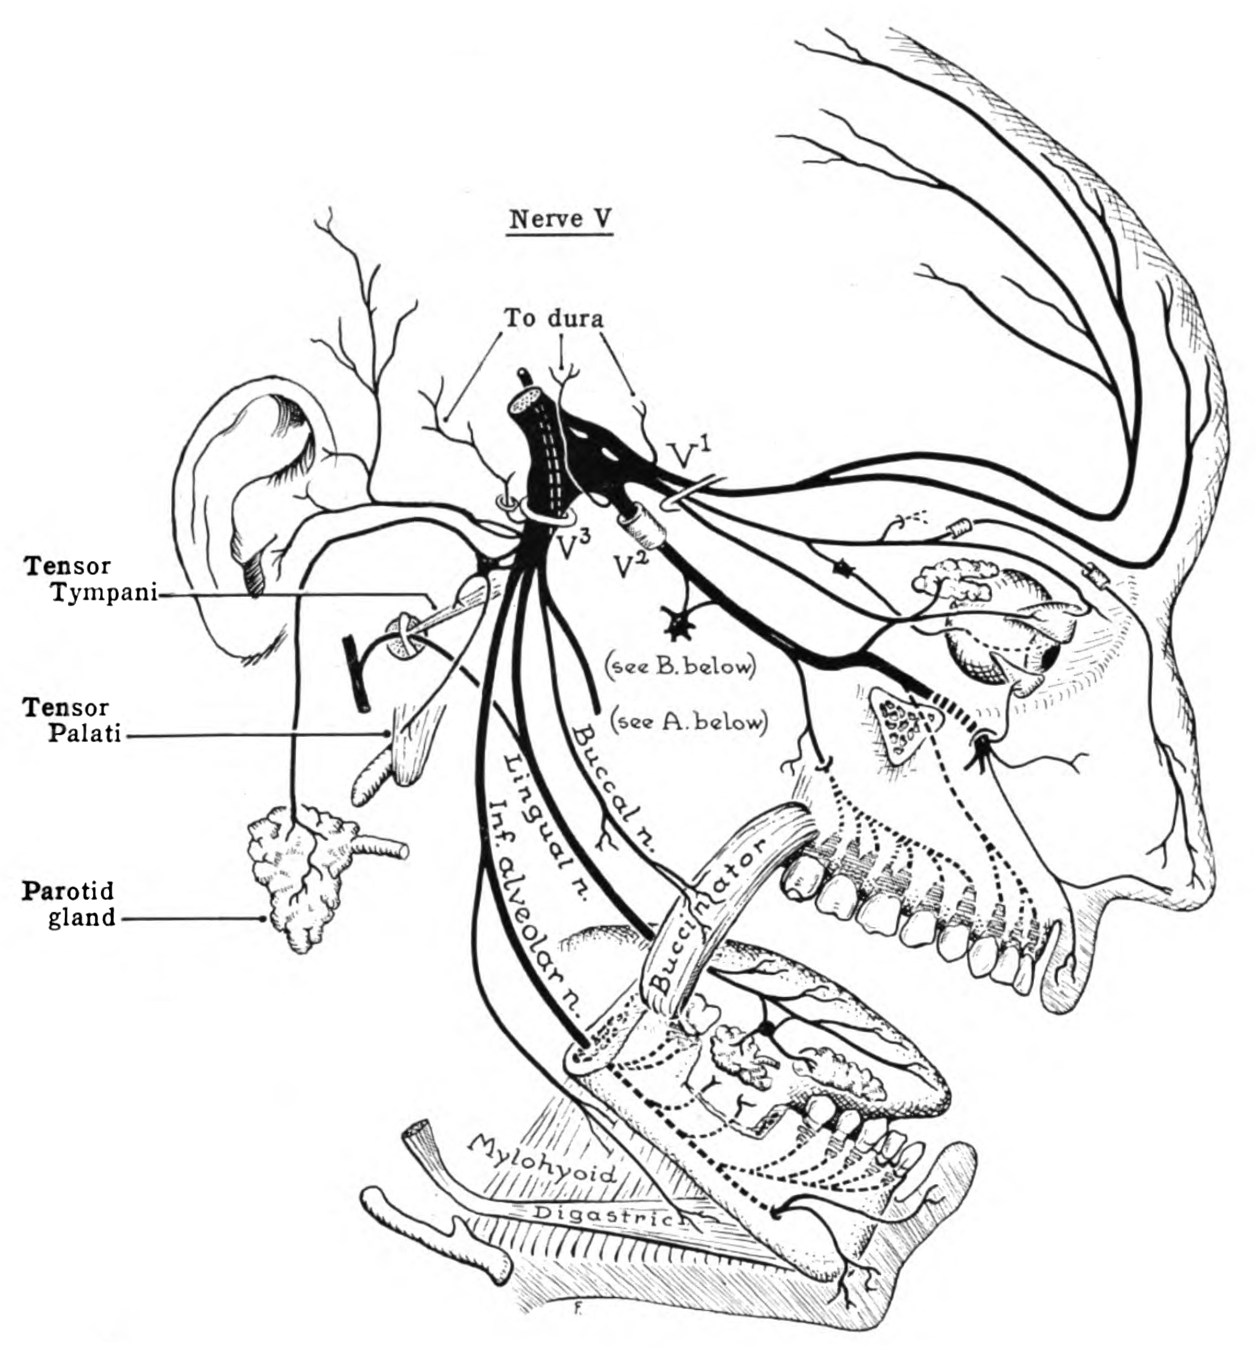
Trigeminal nerve
Stinging of acetic acid
Warming of alcohol
Heat from capsaicin
Cooling from menthol
Spritz of CO₂
Astringency from tannin

Slide 41
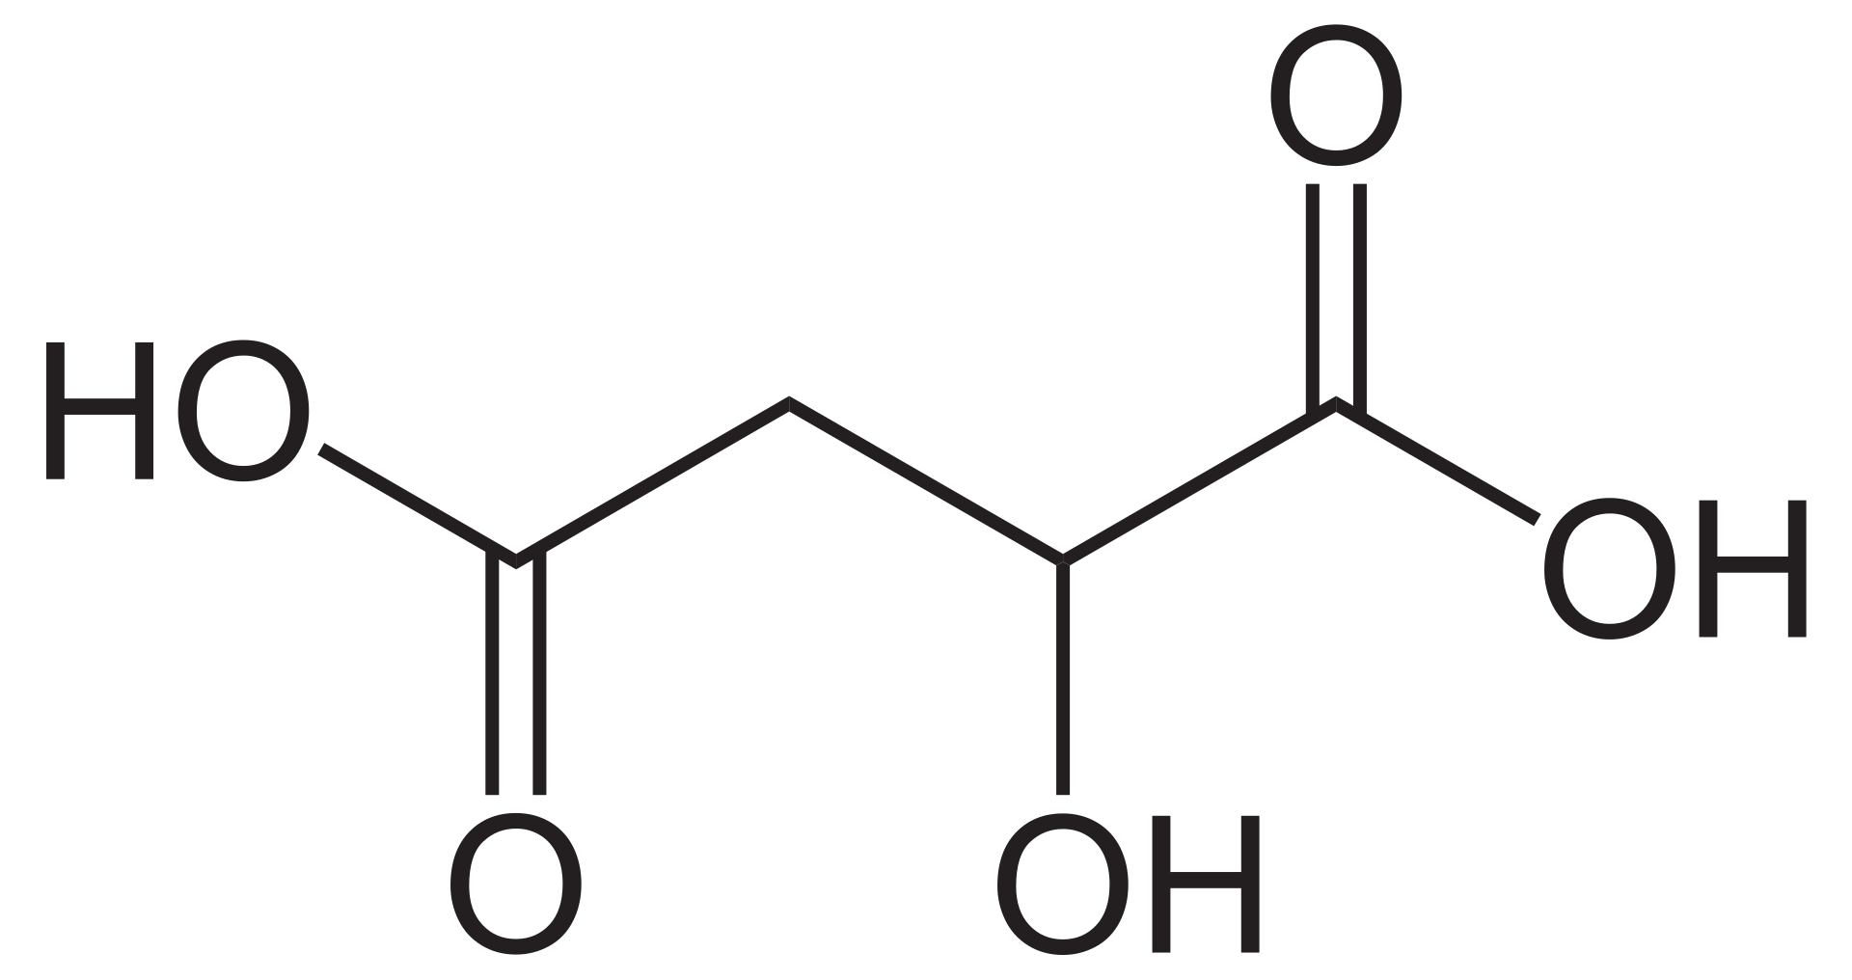
Acids
Volatile acids
Non-volatile acids
Acetic acid
Malic acid

Slide 42
Sample 9
Wine faults

Slide 43
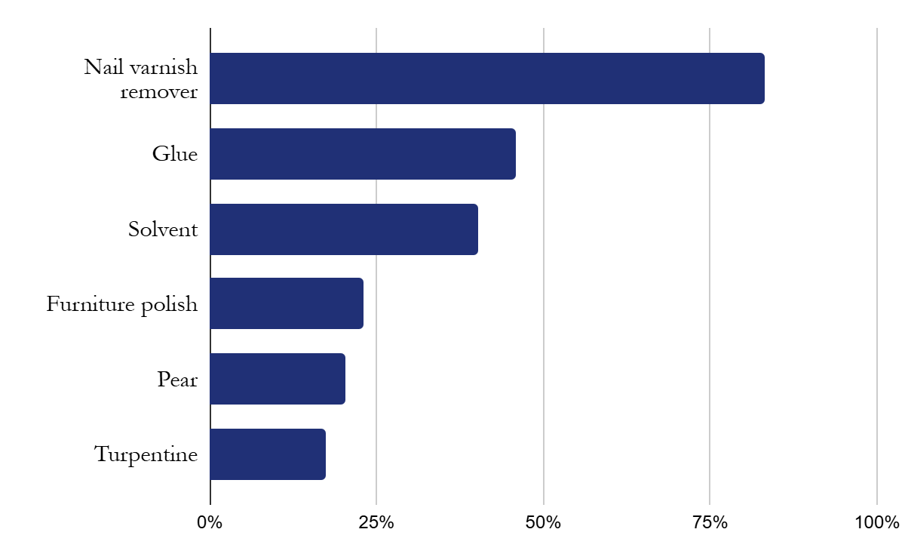
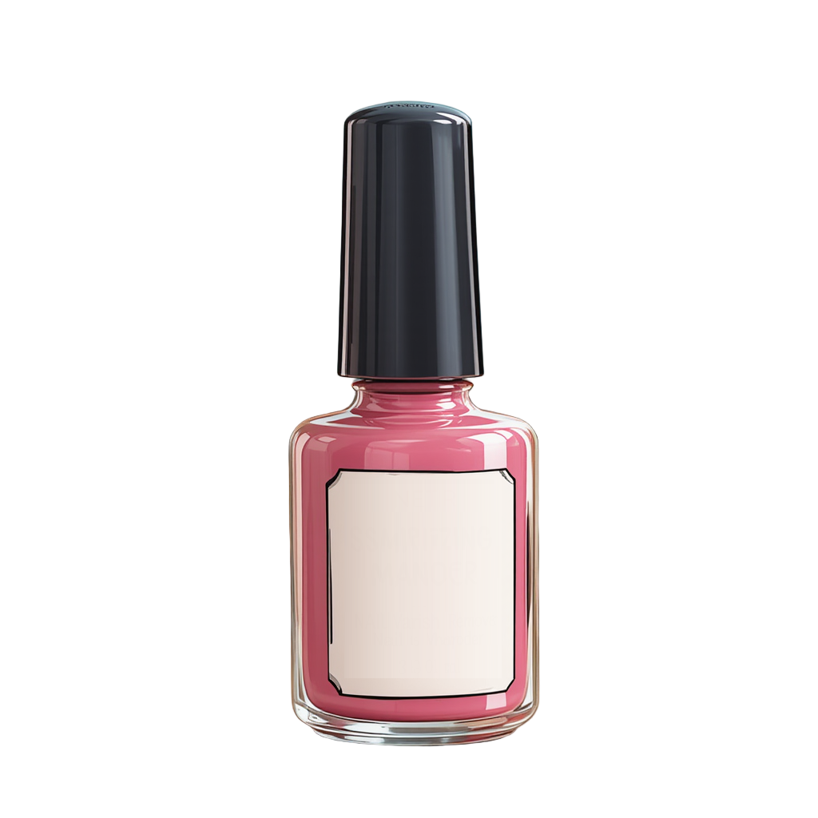
Nail varnish remover
Sample 9
Wine faults

Slide 44

Cover the glass – long sniff
Wine flavour compounds

Slide 45
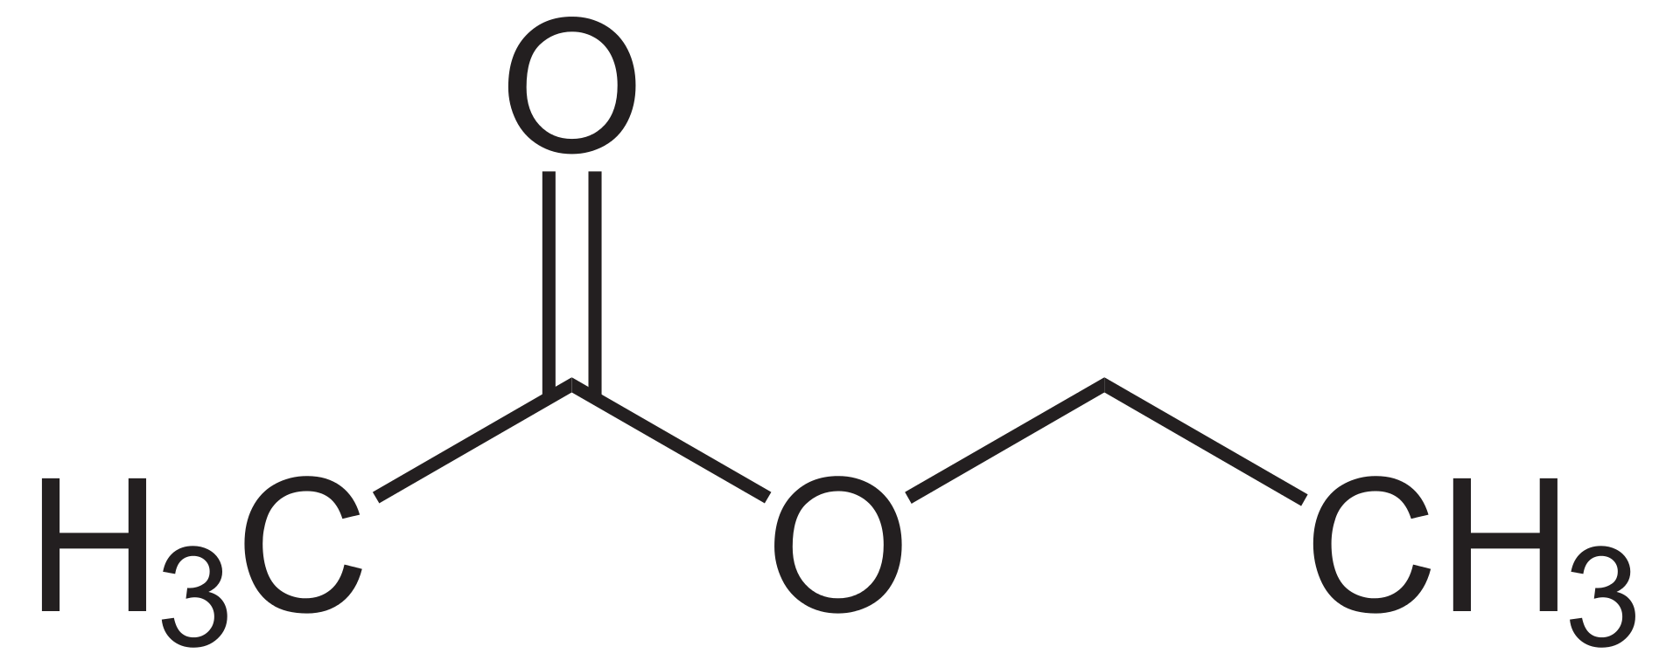
Nail varnish remover
Sample 9
ethyl acetate
Class: Esters
Fault
Volatile acidity
Origins
Wine faults
Threshold:
30 mg/L
Acetic acid bacteria, yeast
Prevention
1 | Wet cardboard
2 | Bruised apple
3 | Brown sugar
4 | Camembert
5 | Smoke
6 | Band-aid
7 | Basmati rice
8 | Vinegar
9 | Nail varnish remover
10
Managing oxygen

Slide 46
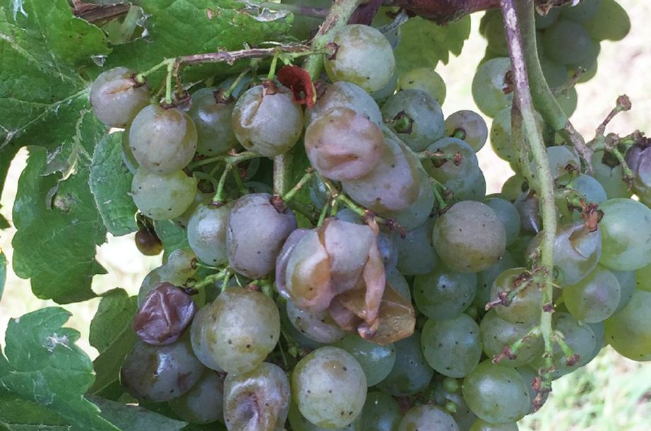
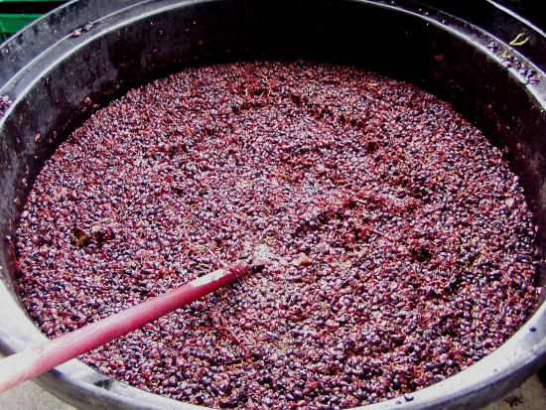
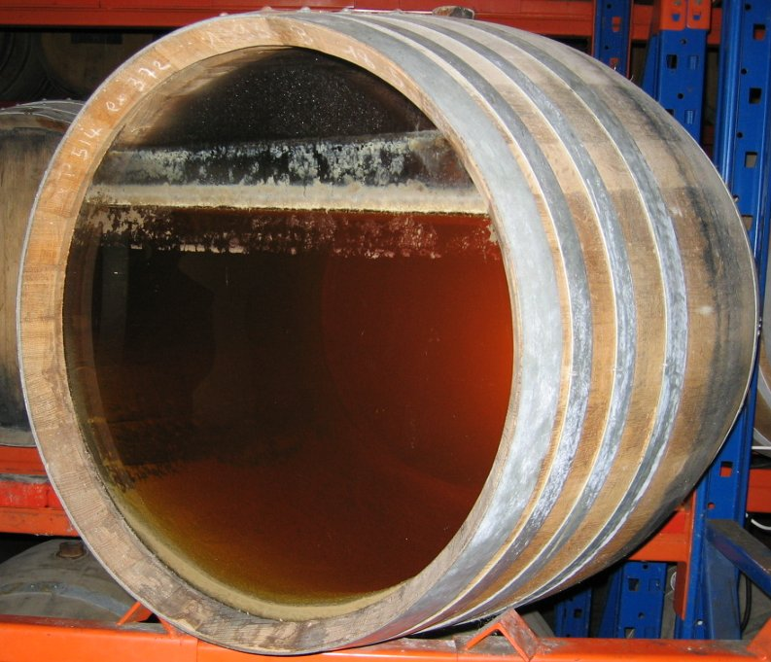
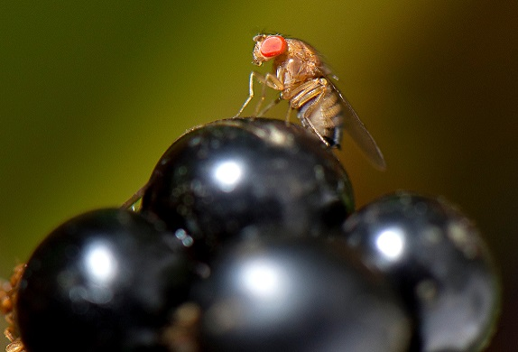
Nail varnish remover
Sample 9
Photo courtesy of Word on the Grapevine
Wine faults
Photo courtesy of Decanter
Photo courtesy of Decanter

Slide 47
Sample 10
Wine faults

Slide 48
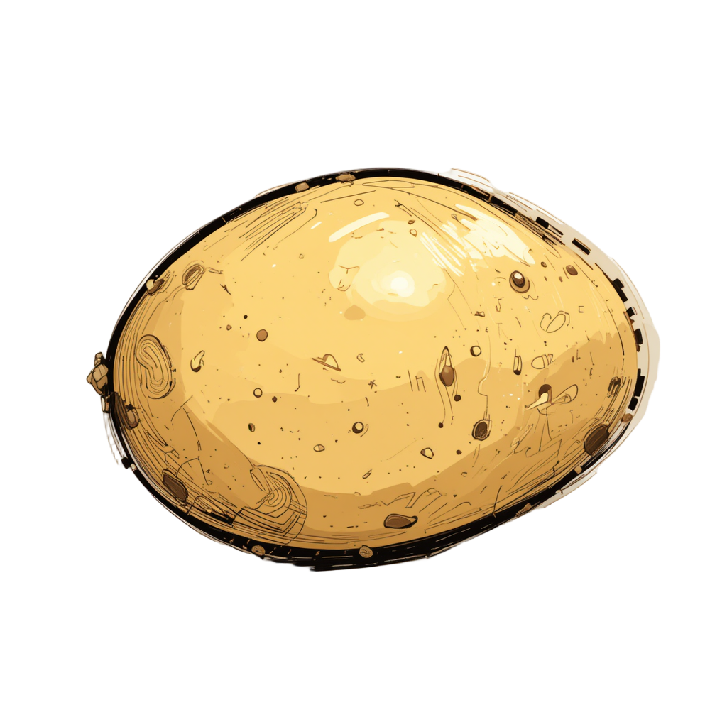
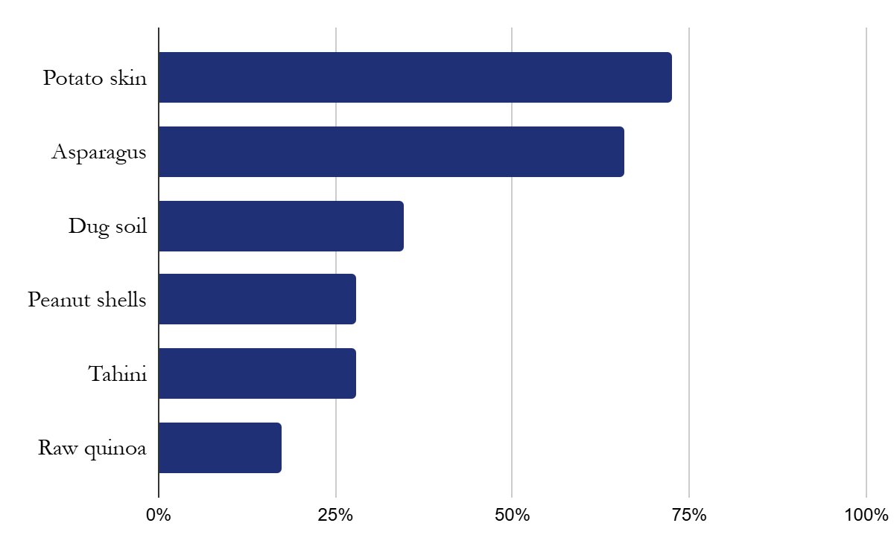
Potato skin
Sample 10
Wine faults

Slide 49
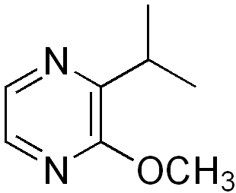
Potato skin
Sample 10
3-isopropyl-2-methoxypyrazine
Class: Pyrazines
Fault
Ladybird taint
Origins
Wine faults
Ladybird invasions, climate change
Threshold:
1 ng/L
Prevention
1 | Wet cardboard
2 | Bruised apple
3 | Brown sugar
4 | Camembert
5 | Smoke
6 | Band-aid
7 | Basmati rice
8 | Vinegar
9 | Nail varnish remover
10 | Potato skin
Removing beetles, vineyard management

Slide 50
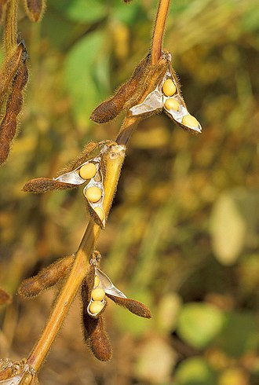
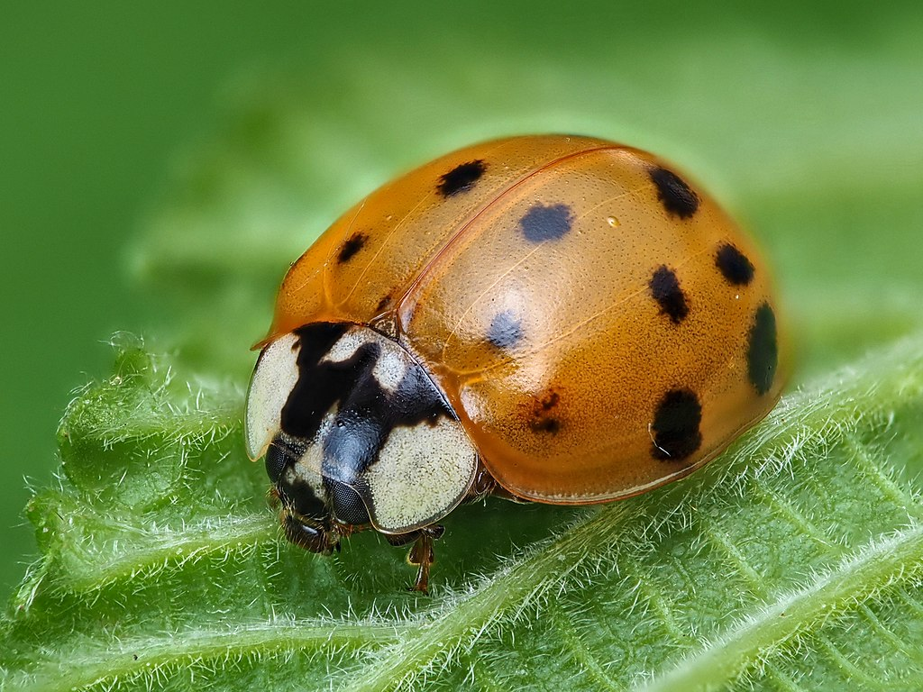
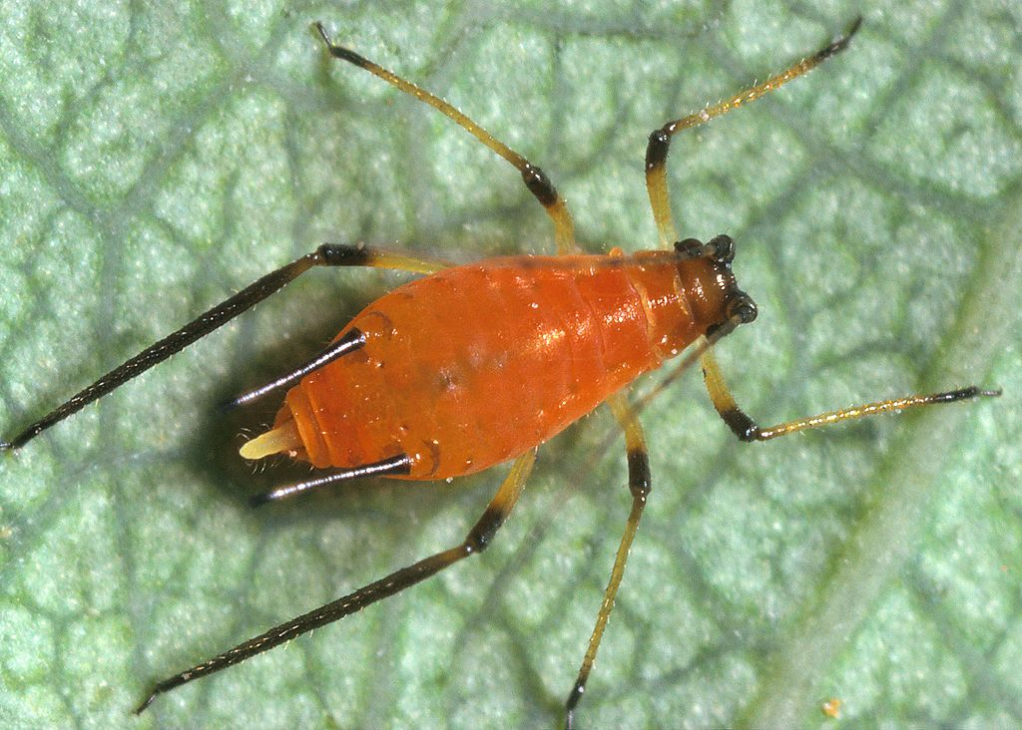
Notes:
Wikipedia pictures

Slide 51




Pyrazines
Methoxypyrazines
Other pyrazines
3-isobutyl-2-
methoxypyrazine
3-isopropyl-2-
methoxypyrazine
2,3,5-trimethylpyrazine

Slide 52
Specific anosmia rates
6 | Band-aid | 4-EP | Brettanomyces | 3%
7 | Basmati rice | ATHP | Mousiness | 8%
8 | Vinegar | acetic acid | Volatile acidity | 1%
9 | Nail varnish remover | ethyl acetate | Volatile acidity | 3%
10 | Potato skin | 3-isopropyl-2-methoxypyrazine | Ladybird taint | 4%
Wine flavour compounds

Slide 53
Rehearsal
1 | Wet cardboard | TCA
2 | Bruised apple | acetaldehyde
3 | Brown sugar | sotolon
4 | Camembert | methyl mercaptan
5 | Smoke | guaiacol
6 | Band-aid | 4-EP
7 | Basmati rice | ATHP
8 | Vinegar | acetic acid
9 | Nail varnish remover | ethyl acetate
10 | Potato skin | 3-isopropyl-2-methoxypyrazine

Slide 54
Blind tasting test
Blind tasting test
Options
- | Band-aid | 4-EP
- | Basmati rice | ATHP
- | Brown sugar | sotolon
- | Bruised apple | acetaldehyde
- | Camembert | methyl mercaptan
- | Nail varnish remover | ethyl acetate
- | Potato skin | 3-isopropyl-2-methoxypyrazine
- | Smoke | guaiacol
- | Vinegar | acetic acid
- | Wet cardboard | TCA
Wine faults
Notes:
I have changed the position of at least some of the glasses. There are no tricks. The reference glass is still in the same place. Please identify the flavours in the 10 glasses. Please do not discuss your answers. Your results will stay anonymous. Spend some time on your reference glass. You have about 15 minutes. Ignore QR code for the time being. These are your options in alphabetical order. Any questions?

Slide 55
Blends
Blend bruised apple and brown sugar
Wine faults
Notes:
Oxidised wine

Slide 56
Blends
Blend band-aid and mouse
Wine faults
Notes:
Hygiene issues

Slide 57
Blends
Blend vinegar and nail varnish remover
Wine faults
Notes:
Volatile acidity

Slide 58
Blends
Blend bruised apple/brown sugar and vinegar/nail varnish remover
Wine faults
Notes:
Oxidation + volatile acidity (progressive stage of oxidation/spoilage)

Slide 59
Blends
Blend wet cardboard and smoke
Wine faults
Notes:
No justification for this blend ;)

Slide 60


Thank you
Powerpoint slides:
www.artoftasting.nl
Contact me:
sietze@artoftasting.nl
Weekly educative posts:
www.instagram.com/artoftasting
Future events, tasting kits:
www.artoftasting.nl
Wine faults
Notes:
https://artoftasting.nl/study-materials-wine-faults/
Please empty your glasses in your spittoon.
Thank you! I hope you found this event informative and that it will help you for tasting in the future.

